Slide 1
Abstraction & Representation in Painting
BY NICHOLAS WYATT
www.nicholaswyattstudio.com

Slide 2
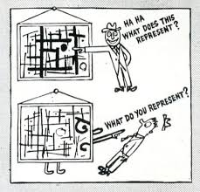
Ad Reinhardt ‘How to look at Art’1946

Slide 3
The paintings shown here both bear the same title ‘Annunciation’. One is abstract and the other is representational. Can they share the same meaning?
Nicholas Wyatt
Annunciation 2003
Nicholas Wyatt
Annunciation 2013

Slide 4
1. What is meant by Representation?
2.What is meant by Abstraction?
3.How is Meaning communicated by Representation and Abstraction?
4.Can two paintings share the same meaning if one is abstract and the other representational?

Slide 5
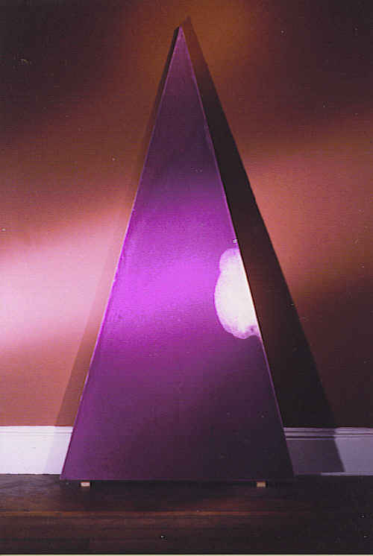
What is Abstraction?
Wilhem Worringer in his book Abstraction and Empathy argued that abstraction (geometric abstraction) has its roots in archaic sacred/ religious ritual and represents idealized forms,
Nicholas Wyatt Trinity 2 2003

Slide 6
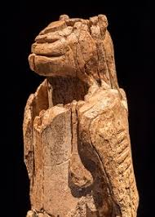
Archaic Abstraction & Representation: the need to represent the world as spirit
Aboriginal Painting
Figurine 40,000BC, Ulm, Germany

Slide 7
The Beginnings of Modern Abstraction
Hilma af klimt Painting 1890.
Hilma af Klimt Portrait

Slide 8
Hilma af Klimt installation of paintings
Installation 1
Installation 2

Slide 9
Concerning the Spiritual in Art
Wassily Kandinsky c.1910
. Georgia OKeefe

Slide 10
Concerning the Spritual in Art
Wassily Kandinsky Painting c.1910
Georgia Okeefe painting c.1918

Slide 11
Georgia okeefe

Slide 12
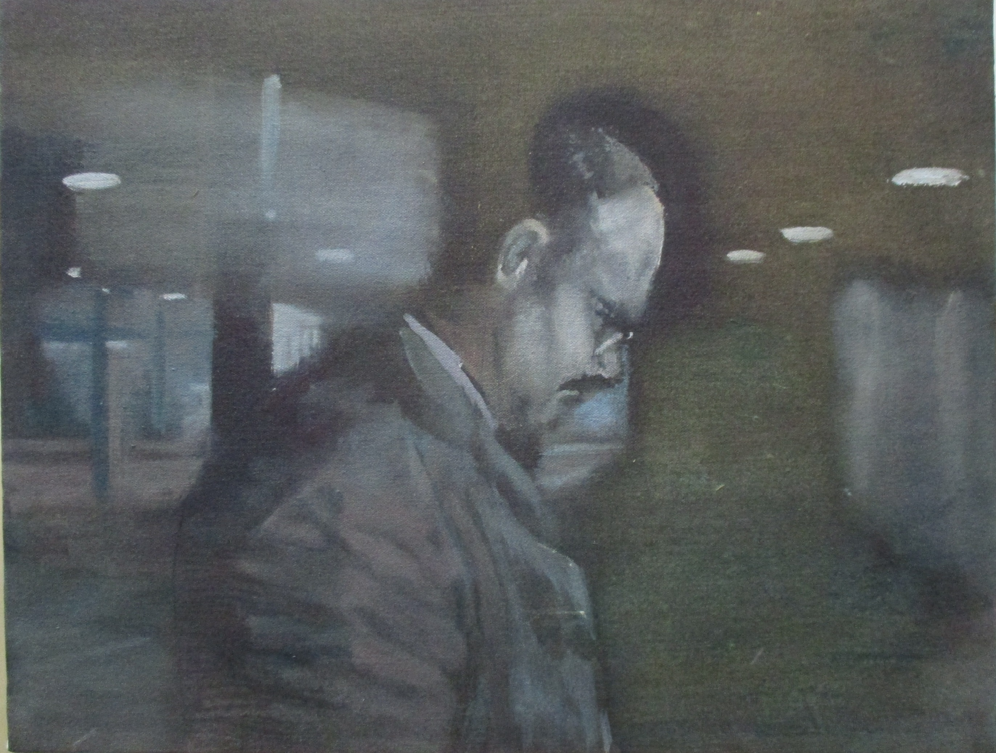
What is representation?
Representational painting, Worringer argued, emerges from a more recent (post-renaissance) awareness of human experience and generates an empathetic response in the viewer.
Nicholas Wyatt The Conversation 2003

Slide 13
Worringer: ‘We sense ourselves in the form of a work of Art’
Rembrandt; The Jewish Bride. 17c
Rembrandt; The Return of the Prodigal Son. 17c.

Slide 14
How is Meaning communicated in Abstract & Representational painting?
Nicholas Wyatt
Heart’s Desire 1991
Nicholas Wyatt
Nordlust 2009

Slide 15
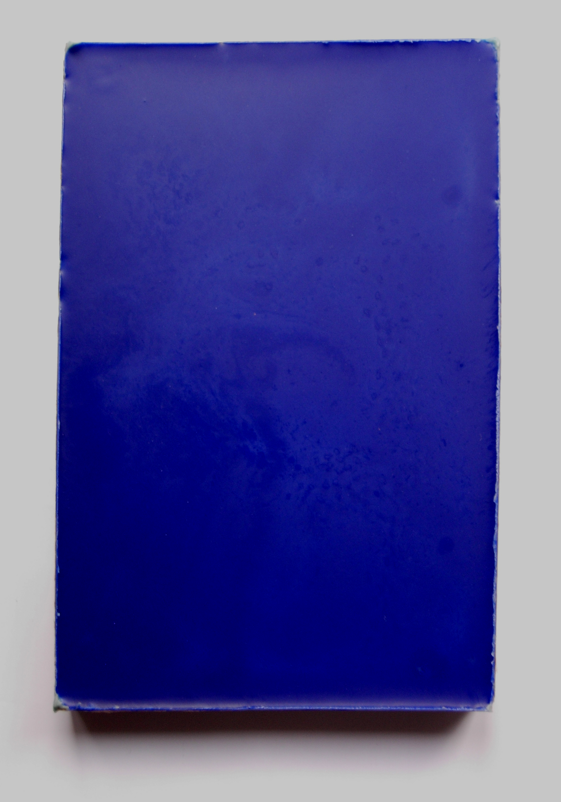
All meaning in Painting at some level is abstract because painting is made of marks which are autonomous of things in the real world. The mark is either autonomous as in abstraction or descriptive -a metaphor (one thing – a brushmark standing in for an object in the real world – as in representational painting
Nicholas Wyatt Blue Painting 2003
Nicholas Wyatt. The Lonely Protestant 1999

Slide 16
Meaning in Abstract painting ‘You cant have a painting about nothing. Just because it does not have a subject, doesn’t mean it lacks content.’ Barnett Newman
Barnett Newman
Piet Mondriaan

Slide 17
Meaning in Representational Painting ‘The subject is not the content’: Newman
Cezanne Painting of Apples
Van Gogh Wheatfield with Cypresses

Slide 18
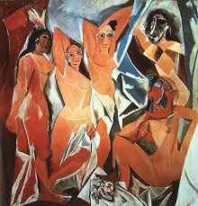
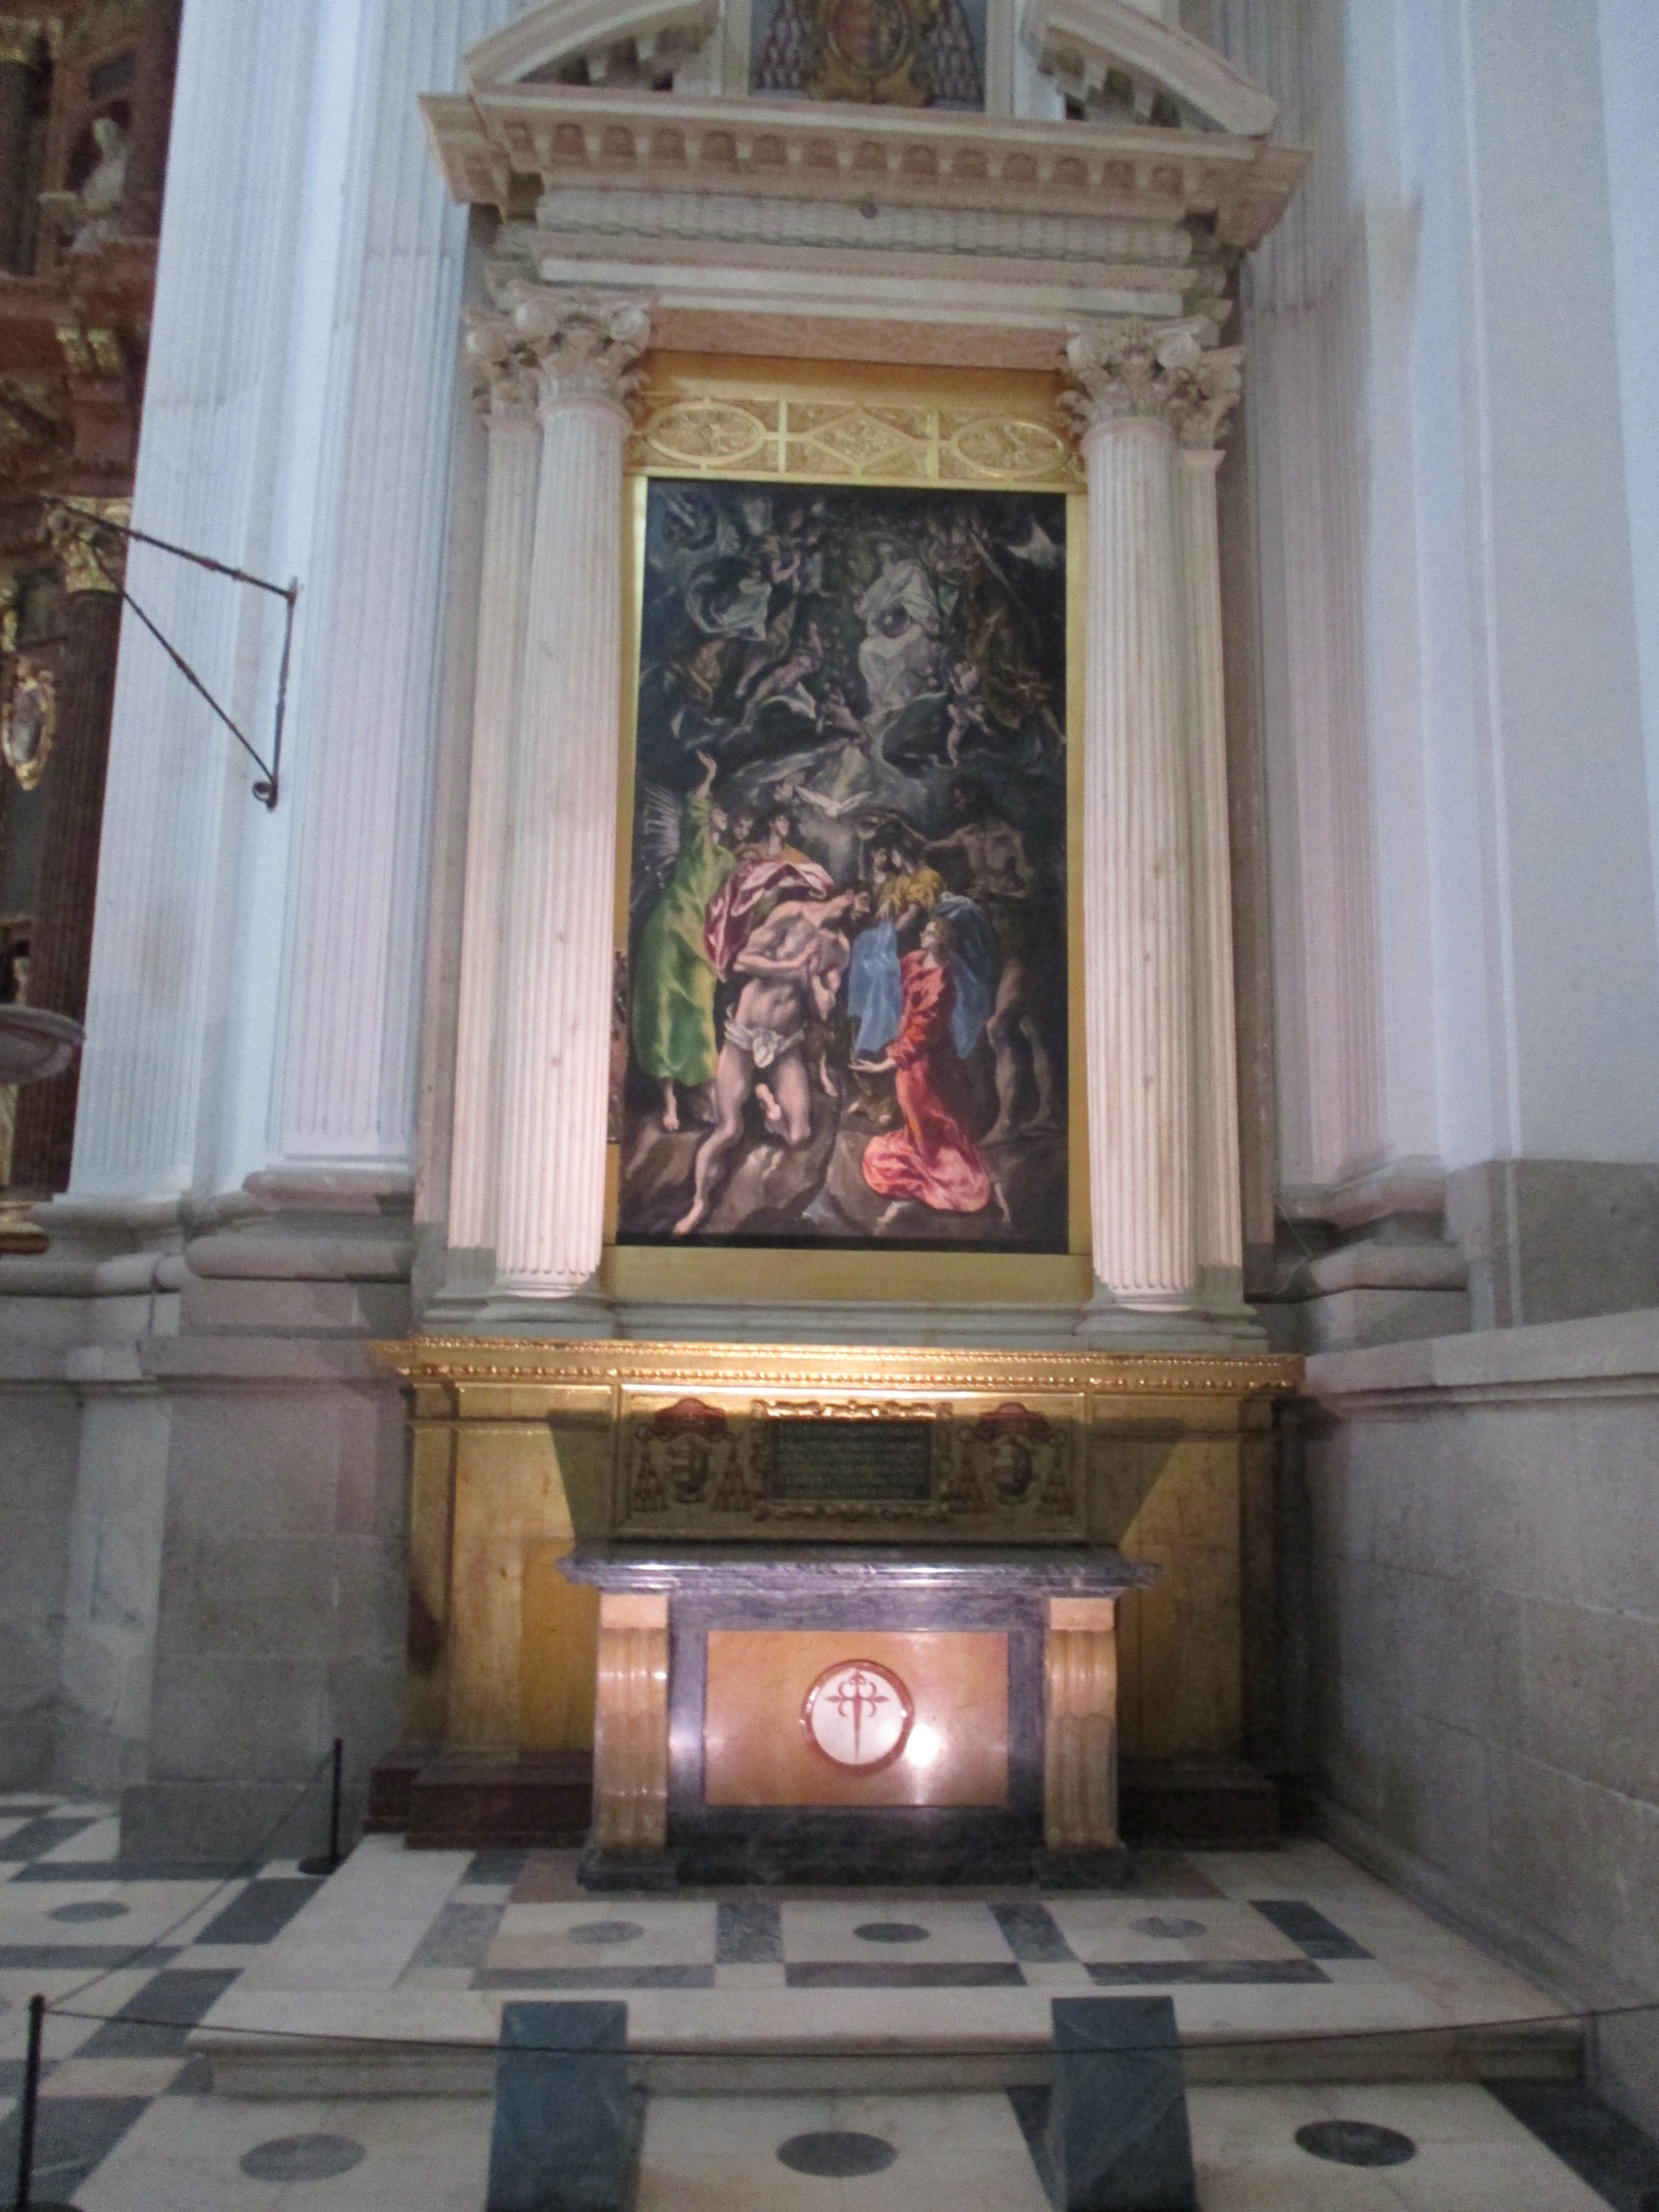
Meaning is communicated in all Painting by Form, Content and Context
FORM
CONTENT
CONTEXT

Slide 19
Can an abstract painting share the same meaning with a representational painting?
Caspar David Friedrich Monk by the Seac.1810
Mark Rothko. Red on Maroon 1950

Slide 20
Nicholas Wyatt Hearts Desire 1991
Nicholas Wyatt. Twilight in the Wilderness (afte rFrederick Edwin Church) 1999
This PowerPoint talk and others by Nicholas Wyatt will be available to download shortly by clicking on www.theartclasswimbledon.wordpress.com

