Slide 1
The Representation of Light in Painting
By Nicholas Wyatt

Slide 2
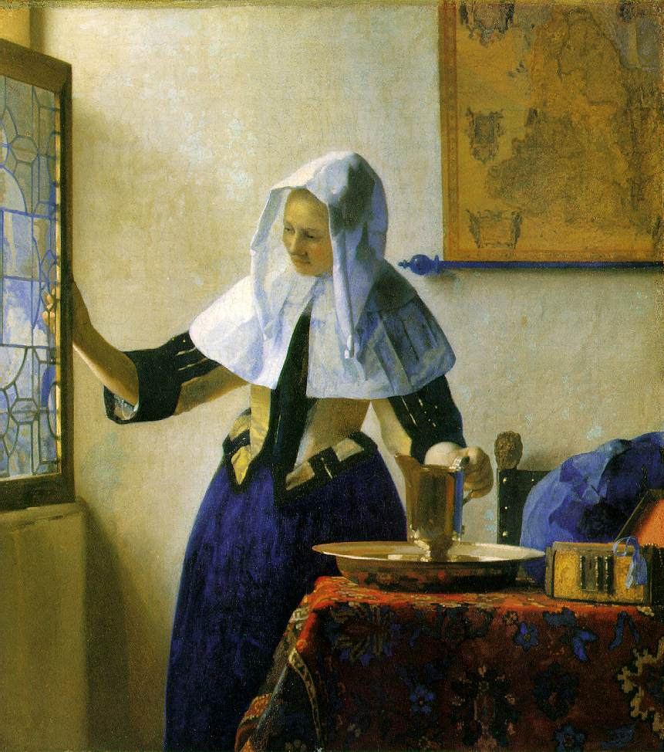
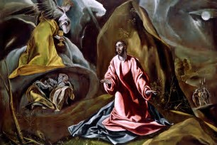
Is ‘The Light of the World ‘ the same light as the Light of The Enlightenment?
El Greco Johannes Vermeer

Slide 3
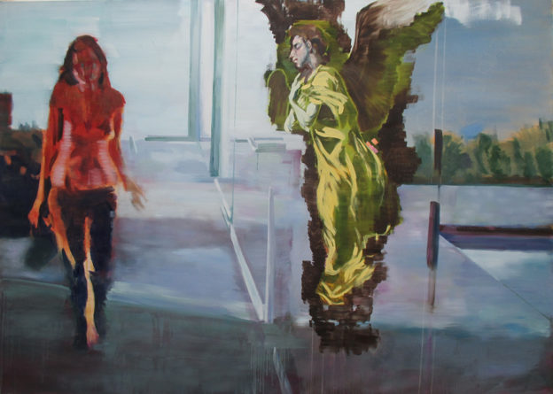
Nicholas Wyatt. Annunciation 2013

Slide 4
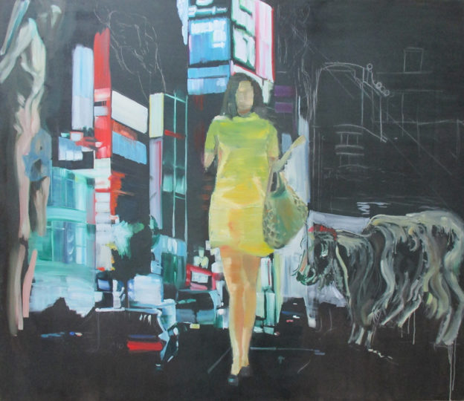
Nicholas Wyatt. All Night Long 2010

Slide 5
Introduction
The representation of light is a fundamental property of painting.
Light is a phenomenon of the physical world, but its representation in painting, like all representations , is culturally determined by social, religious, political and aesthetic factors. And between faith and reason
This presentation will look at the different ways the representation of light light has developed in the European painting tradition over the past 700 years and will consider the question: Is ‘The Light of the World ‘ the same light as the Light of the Enlightenment?’
I look at this development not only from art history, but also from my viewpoint as a painter.

Slide 6
1. Light as Divine Metaphor (Mediaeval Painting)
Saint Augustine of Hippo (354-430 AD)the early Christian theologian and philosopher draws a distinction between the Light of God and the light of the senses.
According to Saint Augustine, the ‘true, good Light’ of God does not reveal earthly, sensual delights or pleasures, but inner, spiritual light .
In mediaeval aesthetics light is conceived as a property of the Divine and light in Mediaeval painting is a clear, lucid, uniform, shadowless and , most importantly, originary quality– that is to say , emanating from the Divine, a good example of which is the stained glass of mediaeval cathedrals, through which the light of God is apprehended through the earthly beauty of colour

Slide 7
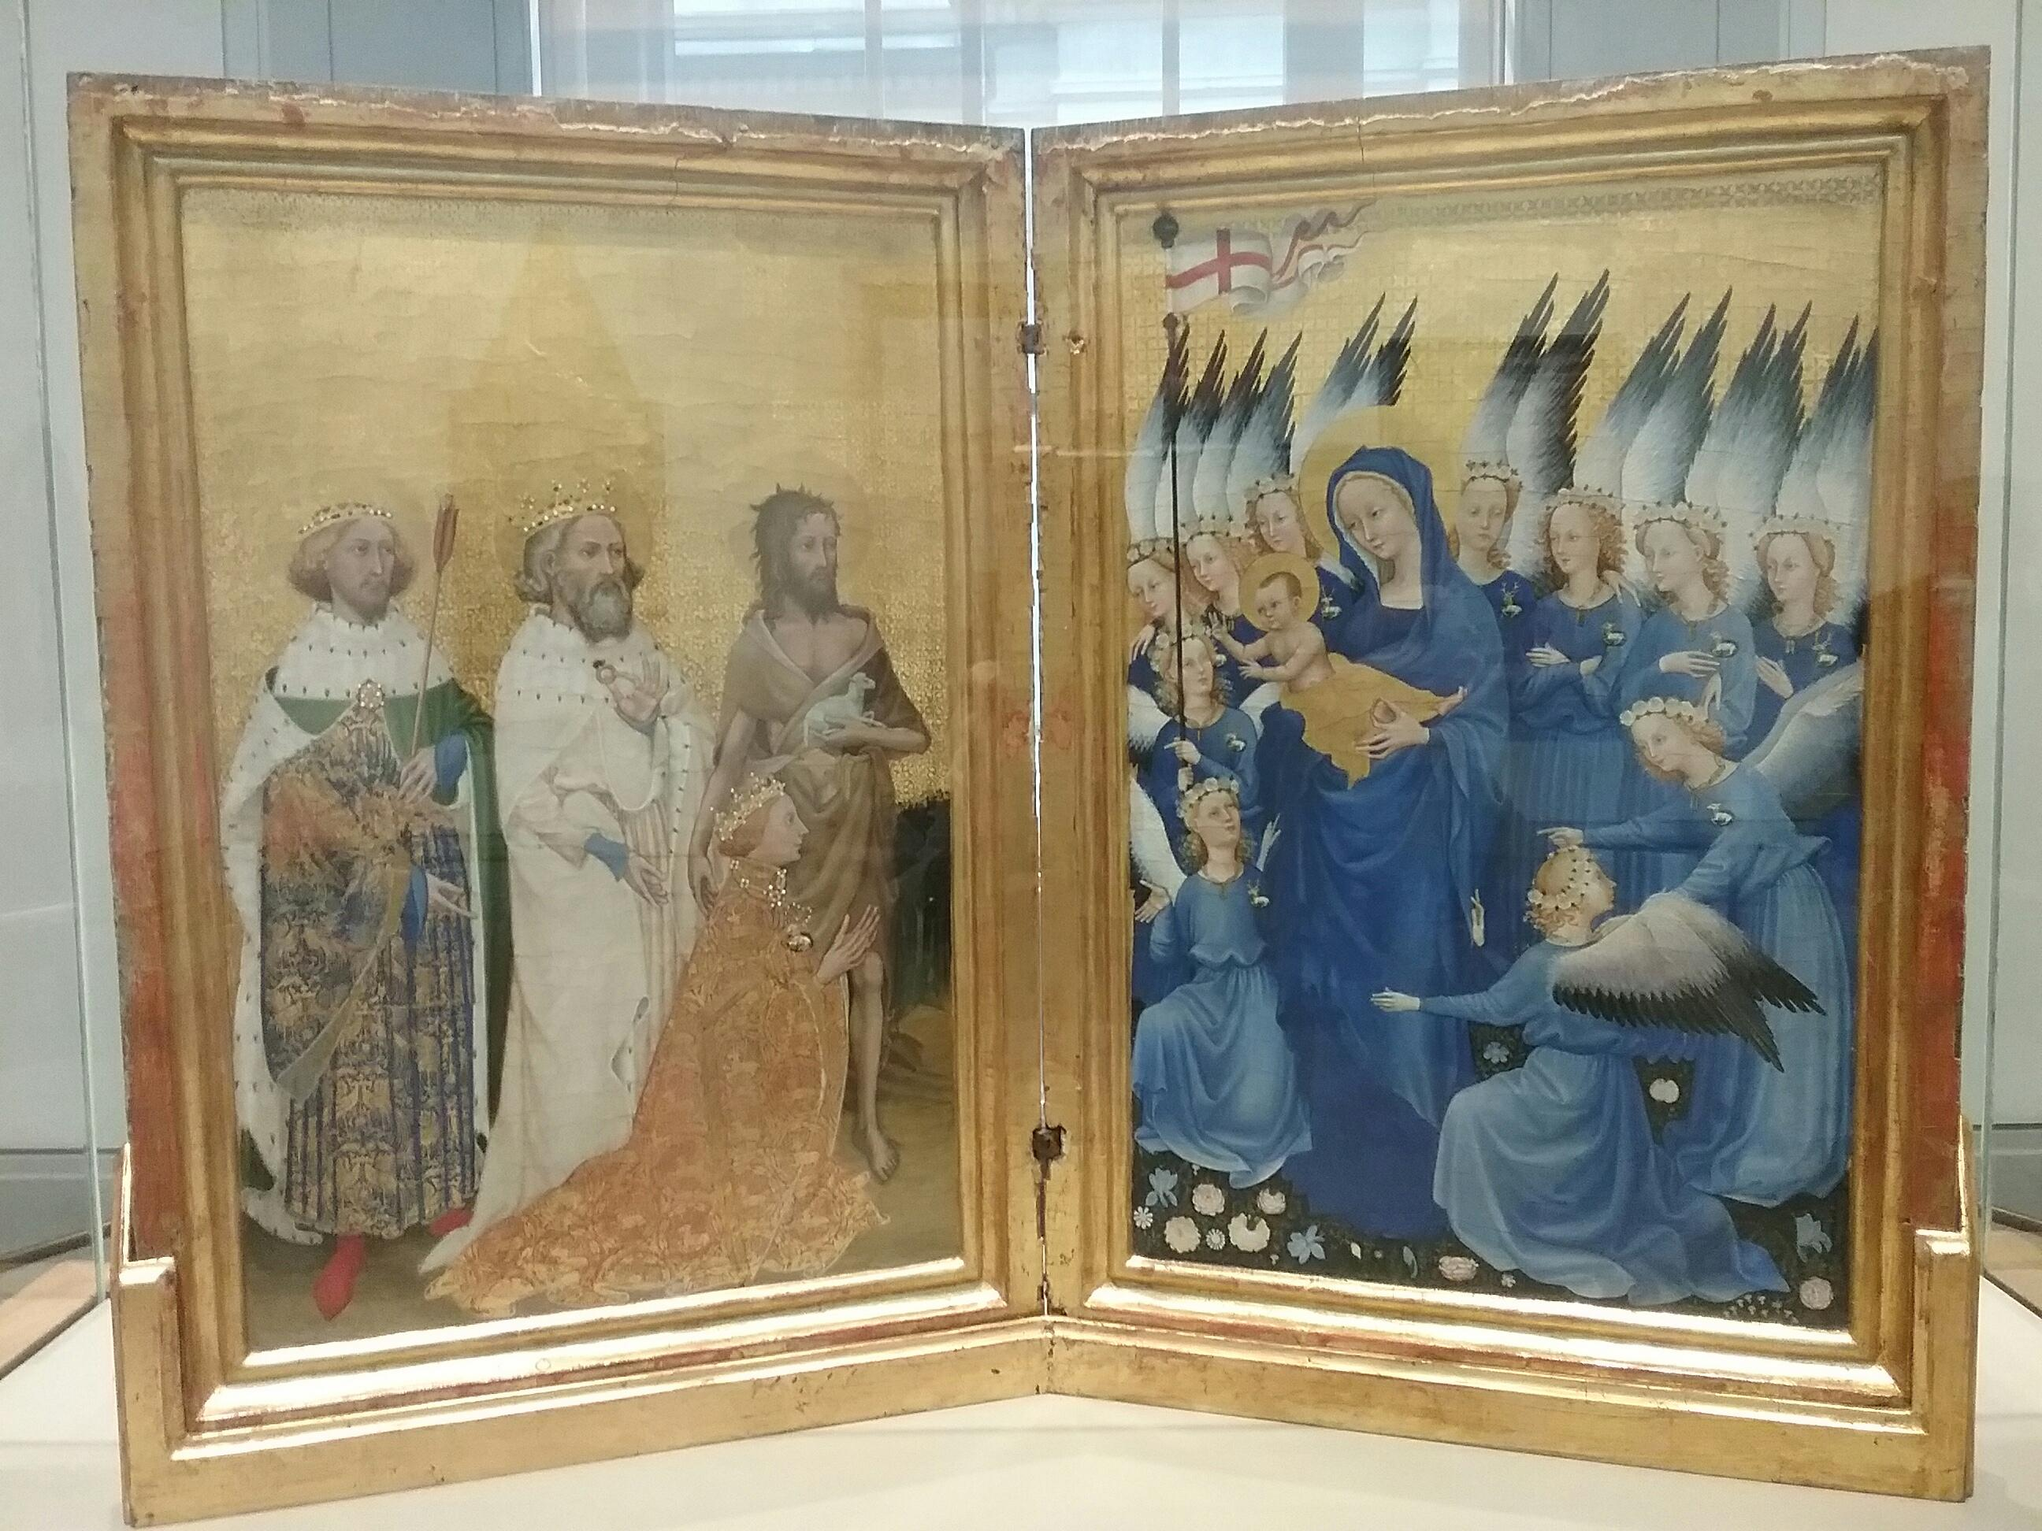
The Wilton Diptych, about 1395-9

Slide 8
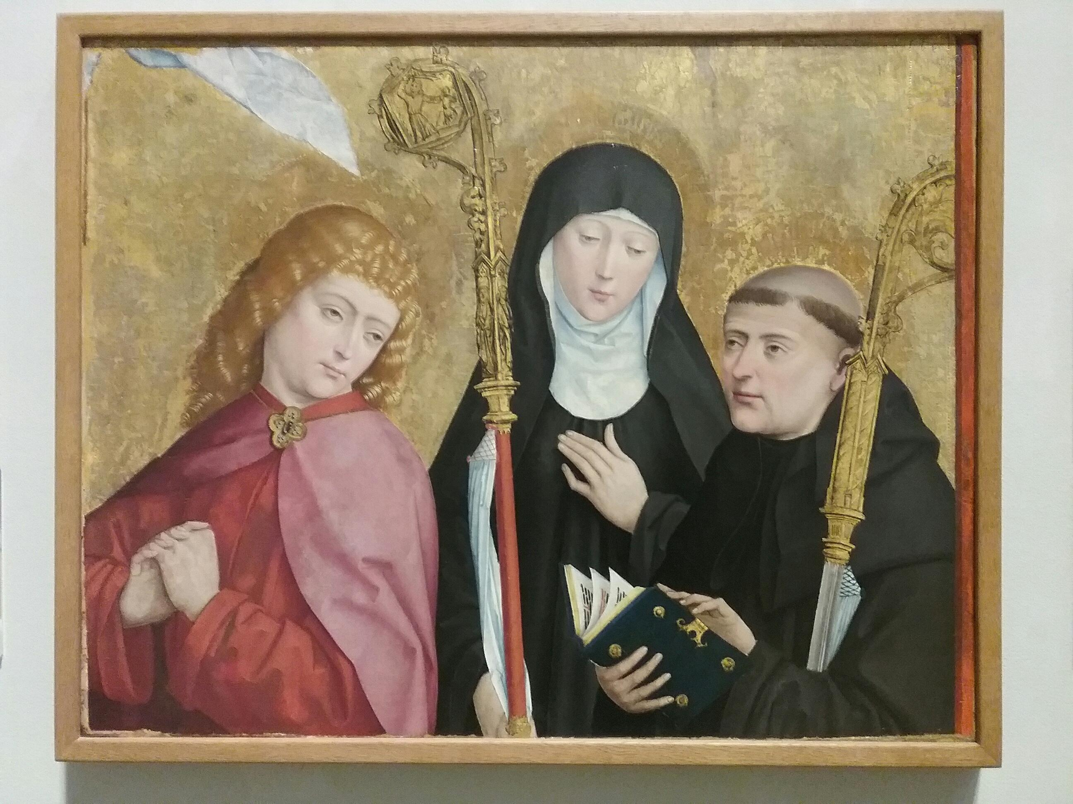
Master of Liesborn. The Liesborn altarpiece, 1465-1490

Slide 9
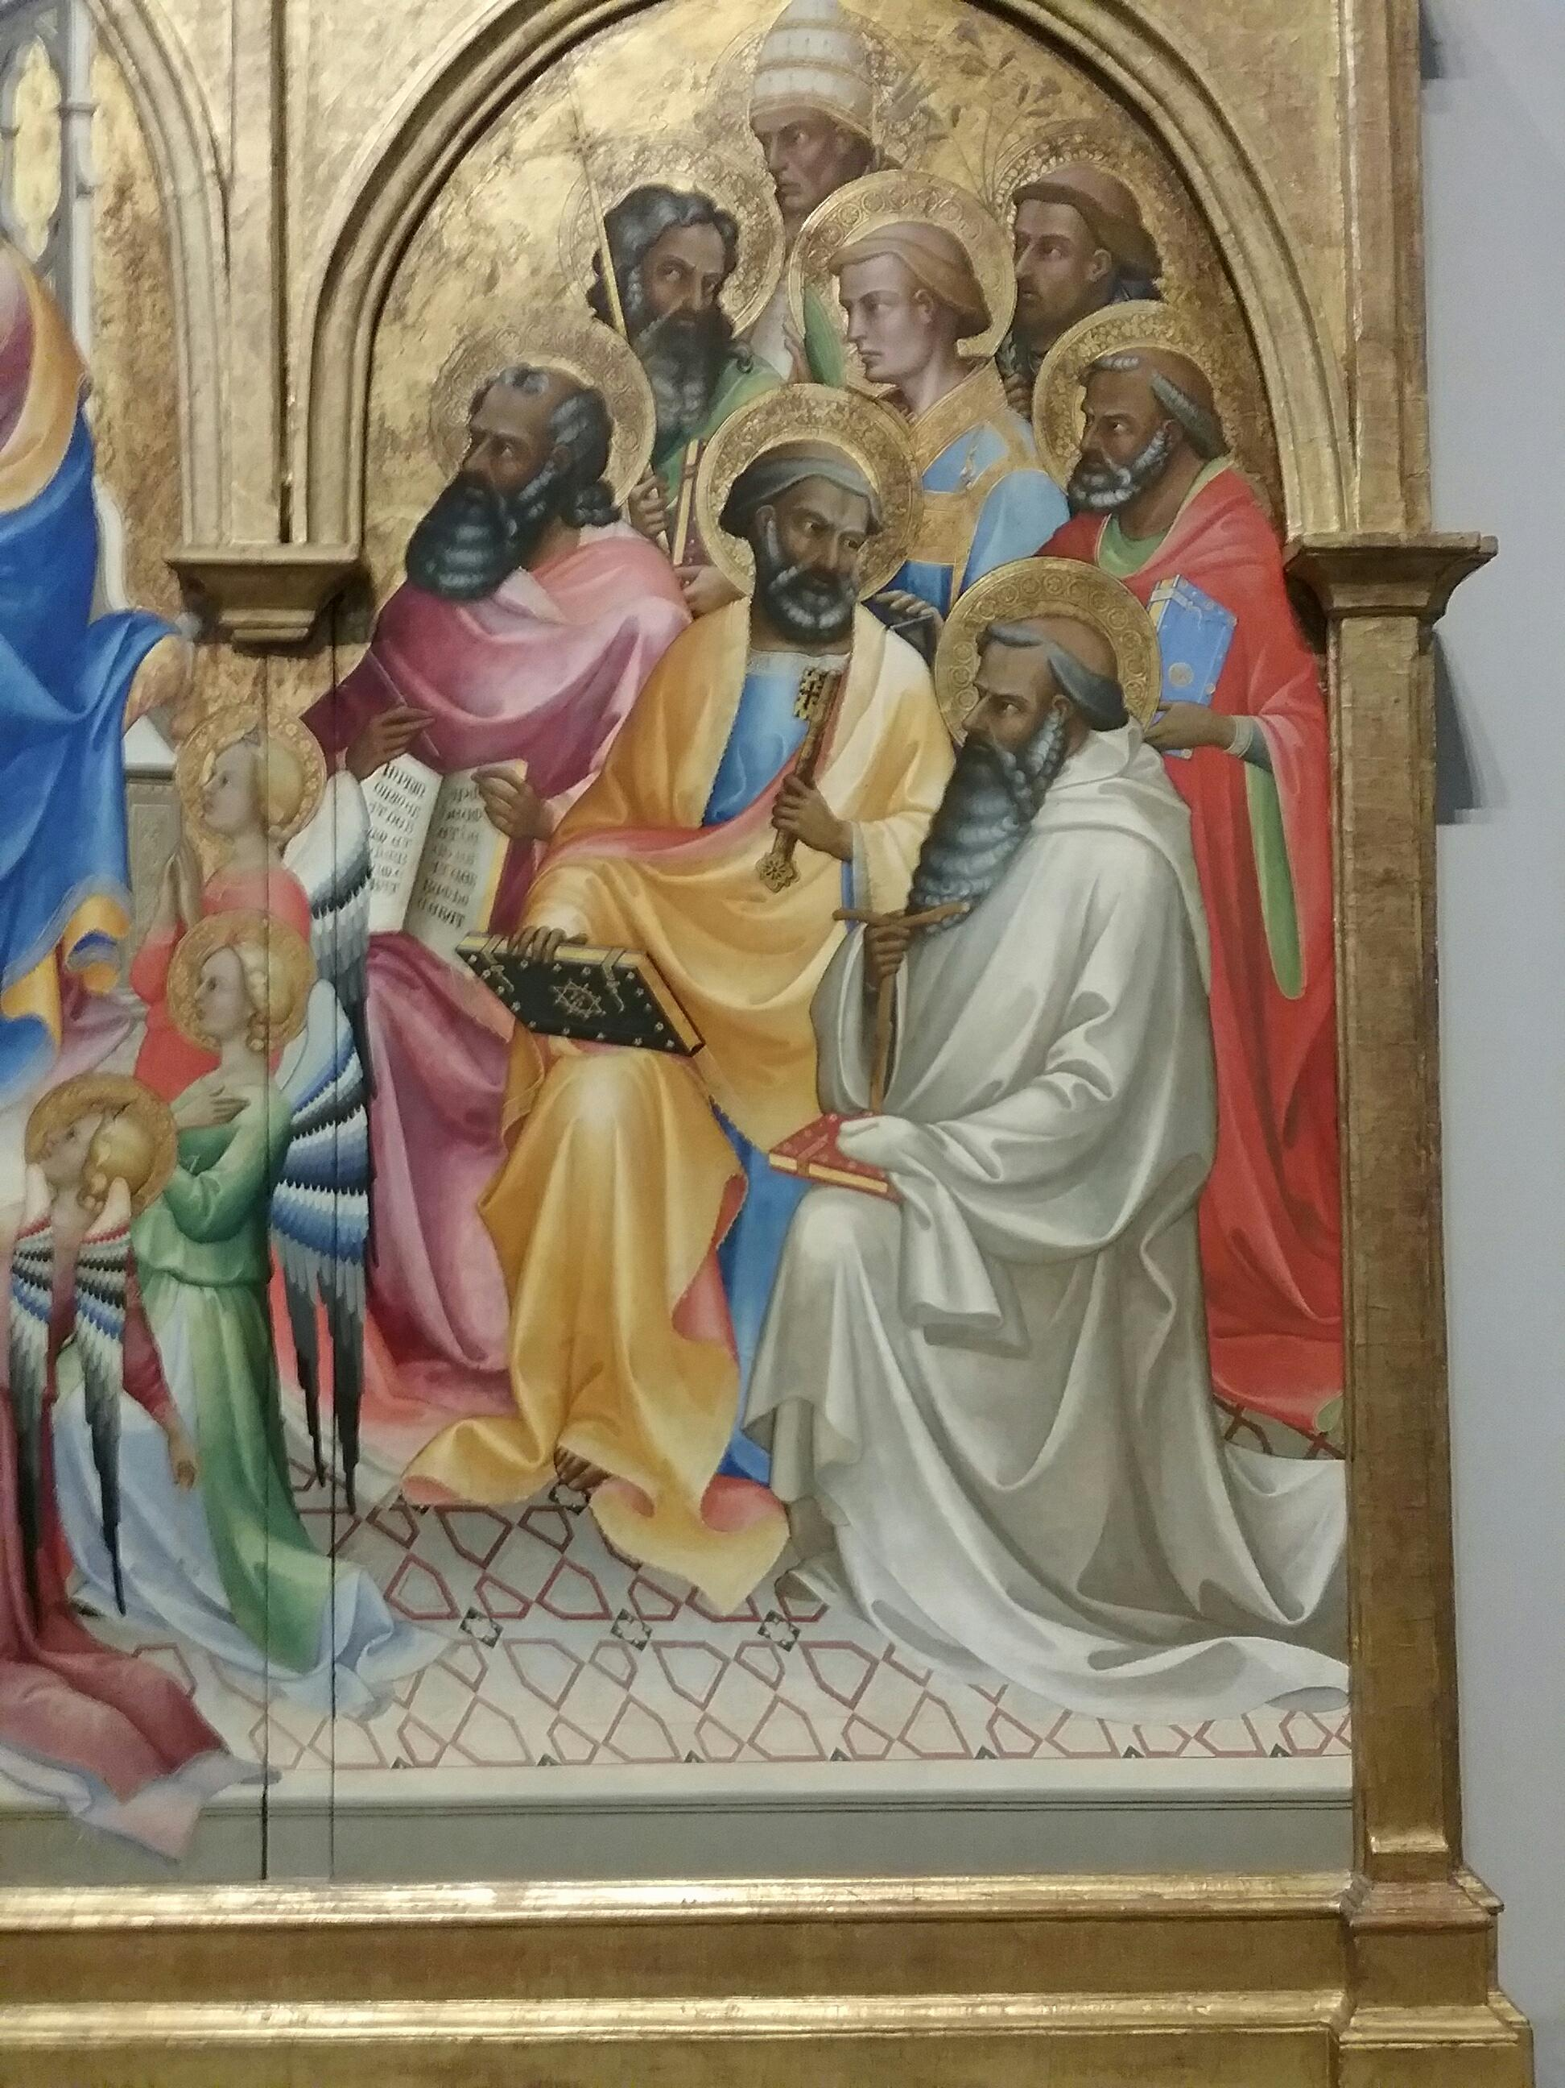
Lorenzo Monaco. The coronation of the virgin with adoring saints 1407-9 (detail)

Slide 10
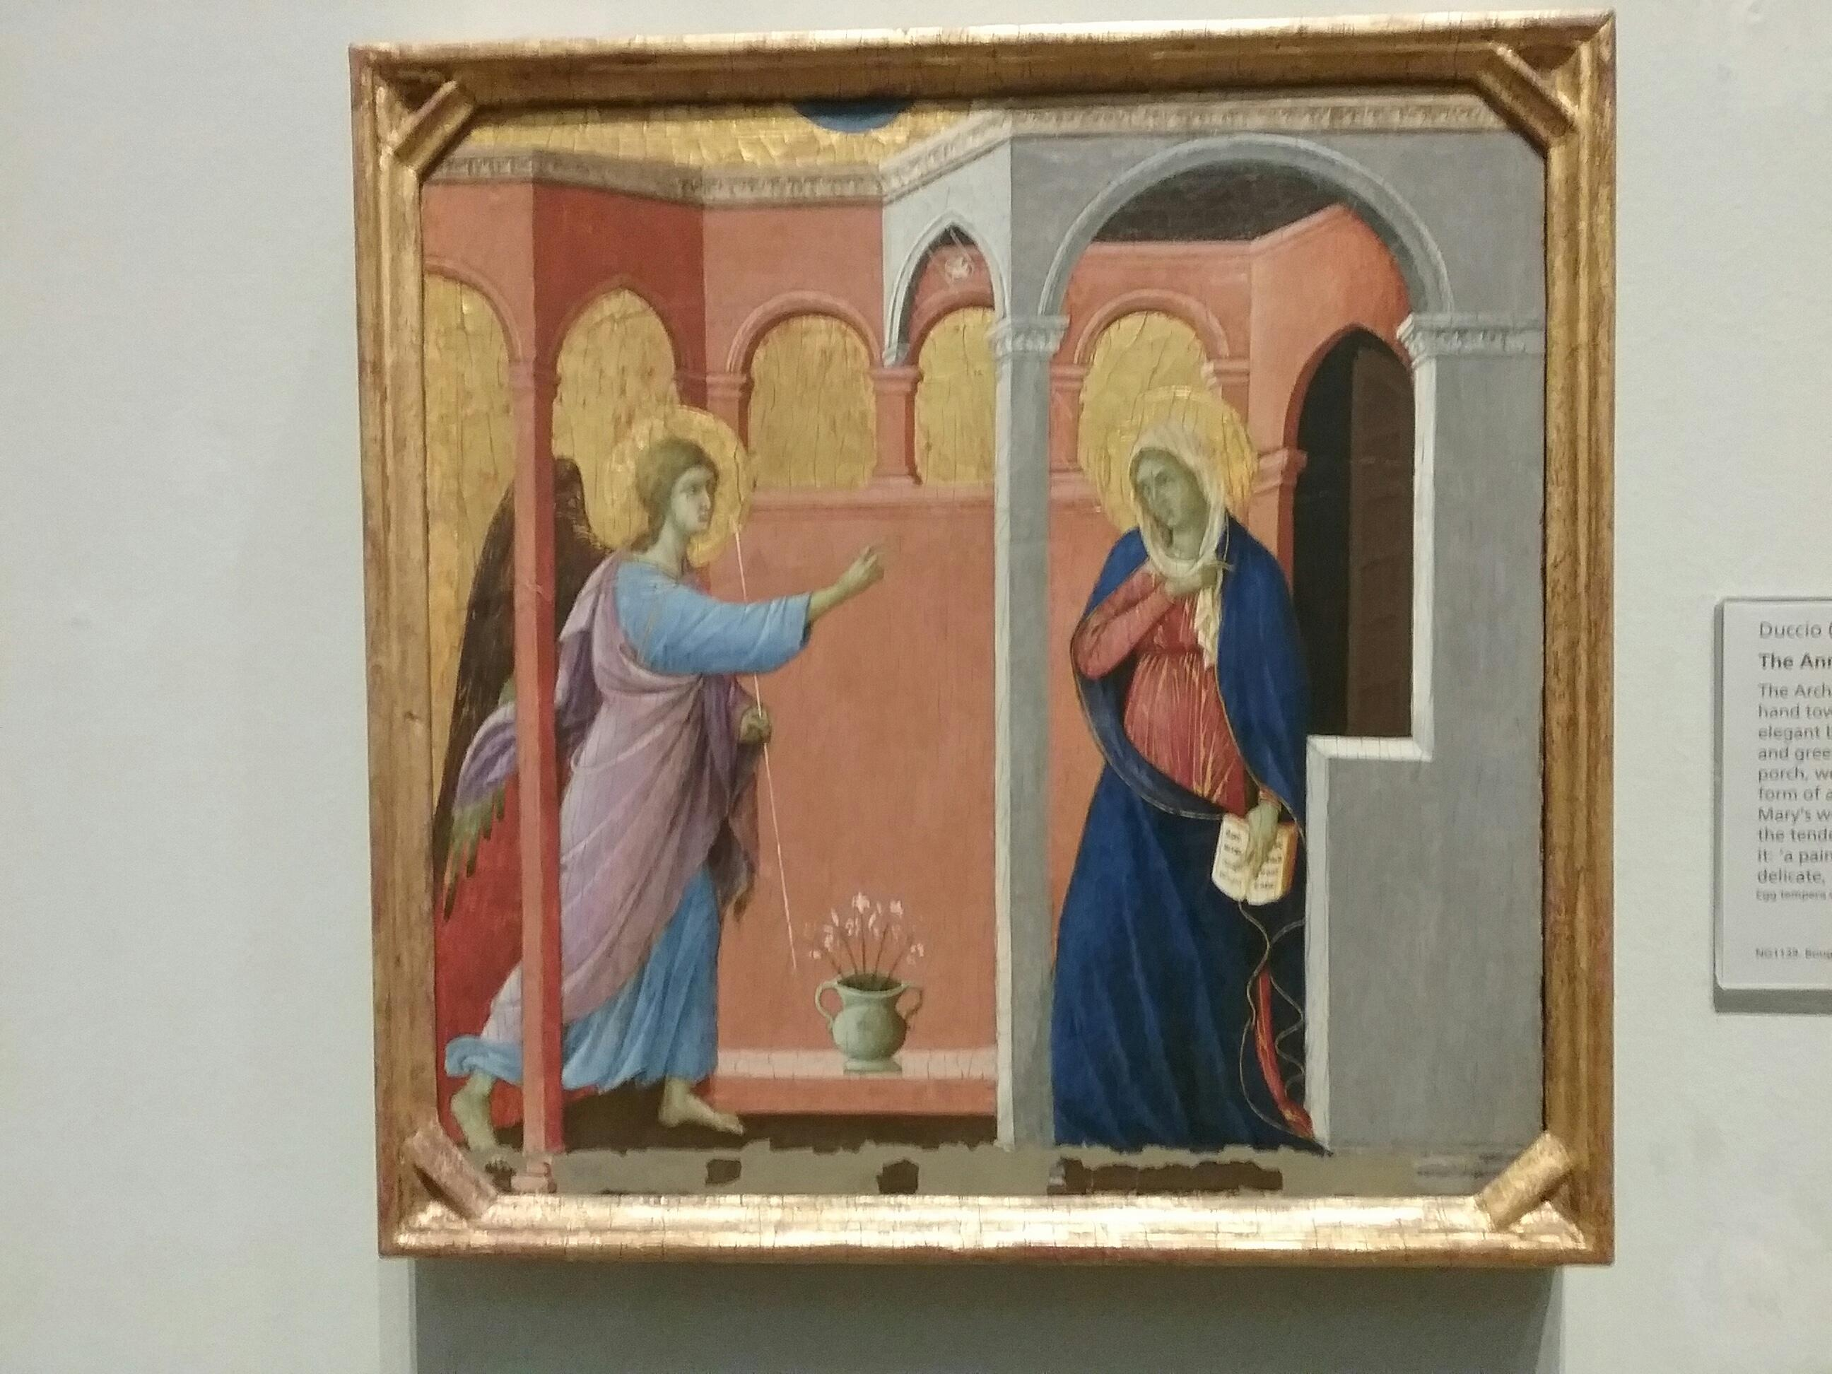
Duccio. The Annunciation. 1307/8-11

Slide 11
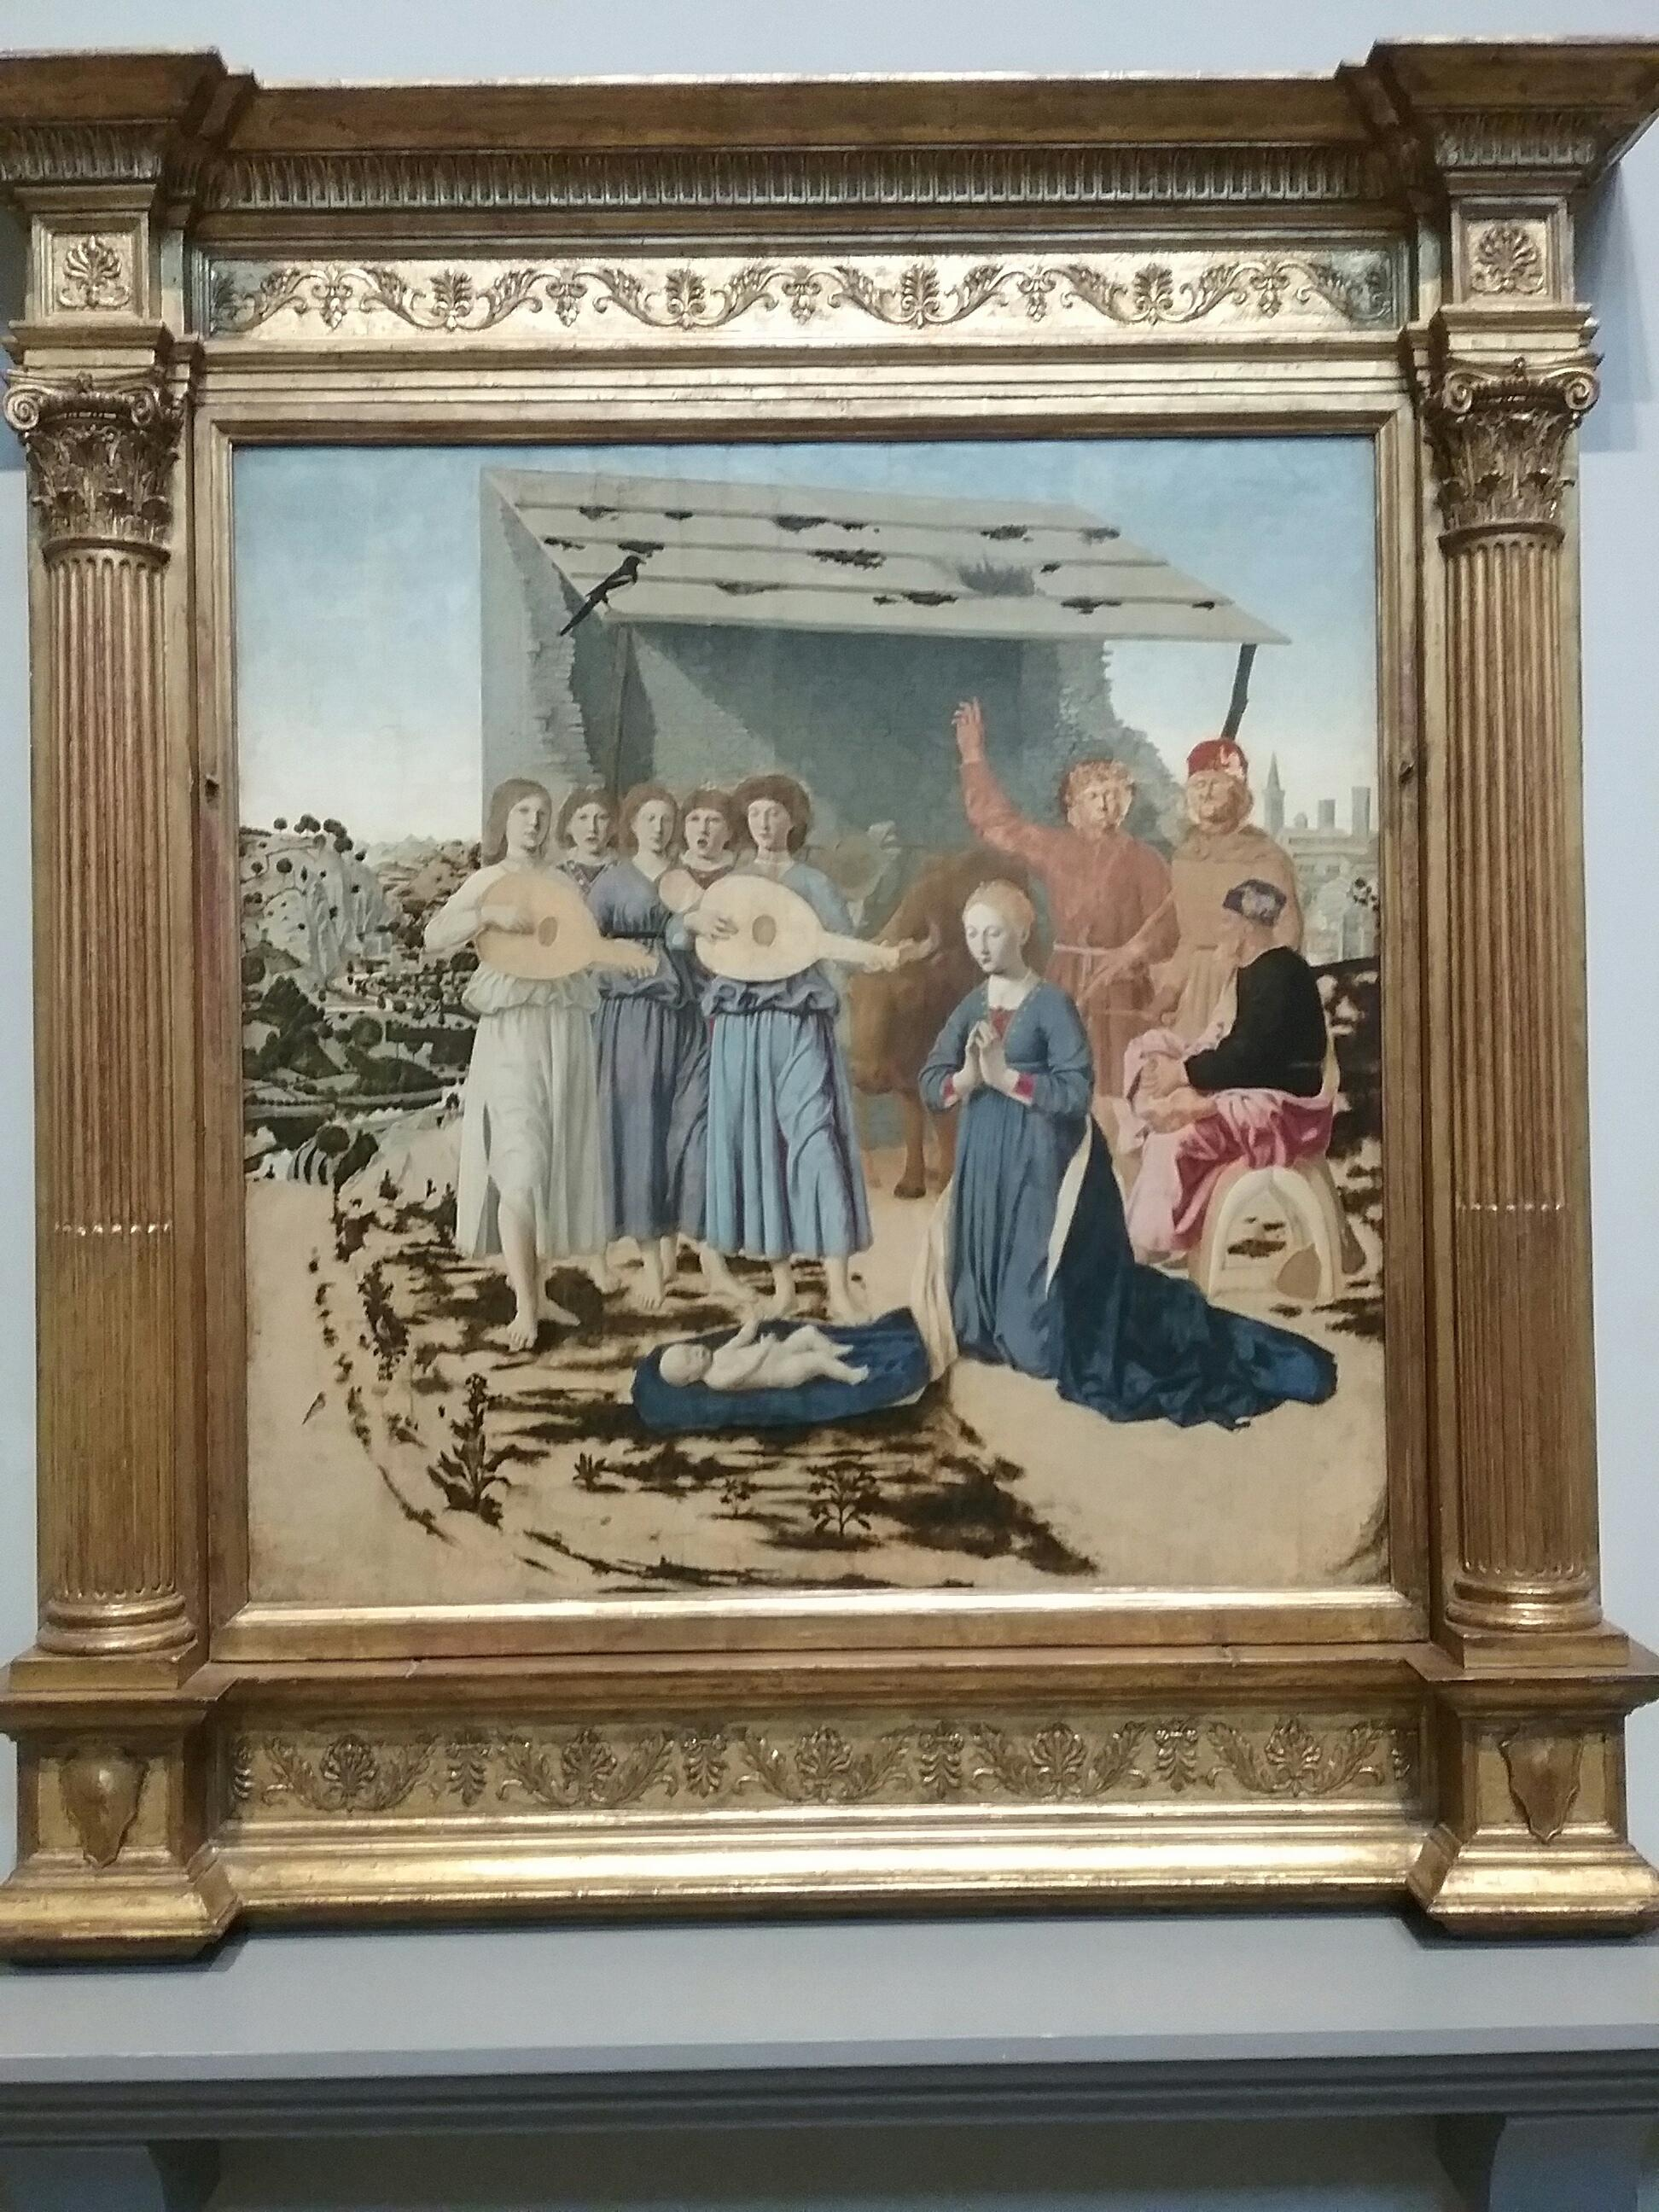
Piero della Francesca. The Nativity. 1470-5

Slide 12
2. Light as Mystical drama and Devotion (da Vinci, El Greco, Caravaggio)
Individualisation and the consciousness of a self gains greater currency in the Renaissance . The sense perception of the individual (and the artist as an individual creator) in relation to the natural world (da Vinci) finds an aesthetic equivalence in da Vinci’s naturalistic representations embodying shadow, chiaroscuro and sfumato.
In contrast to da Vinci’s ’ natural’ mystery, artists in the counter reformation countries – Spain Italy (Caravaggio,ElGreco) in response to the requirements of the counter reformation catholic church produced an art of religious narrative that directed itself and was intended to exc ite the emotions in the service of prayerful devotionreligious meditsation art both elected to use light to convey spiritual drama in thei works.

Slide 13
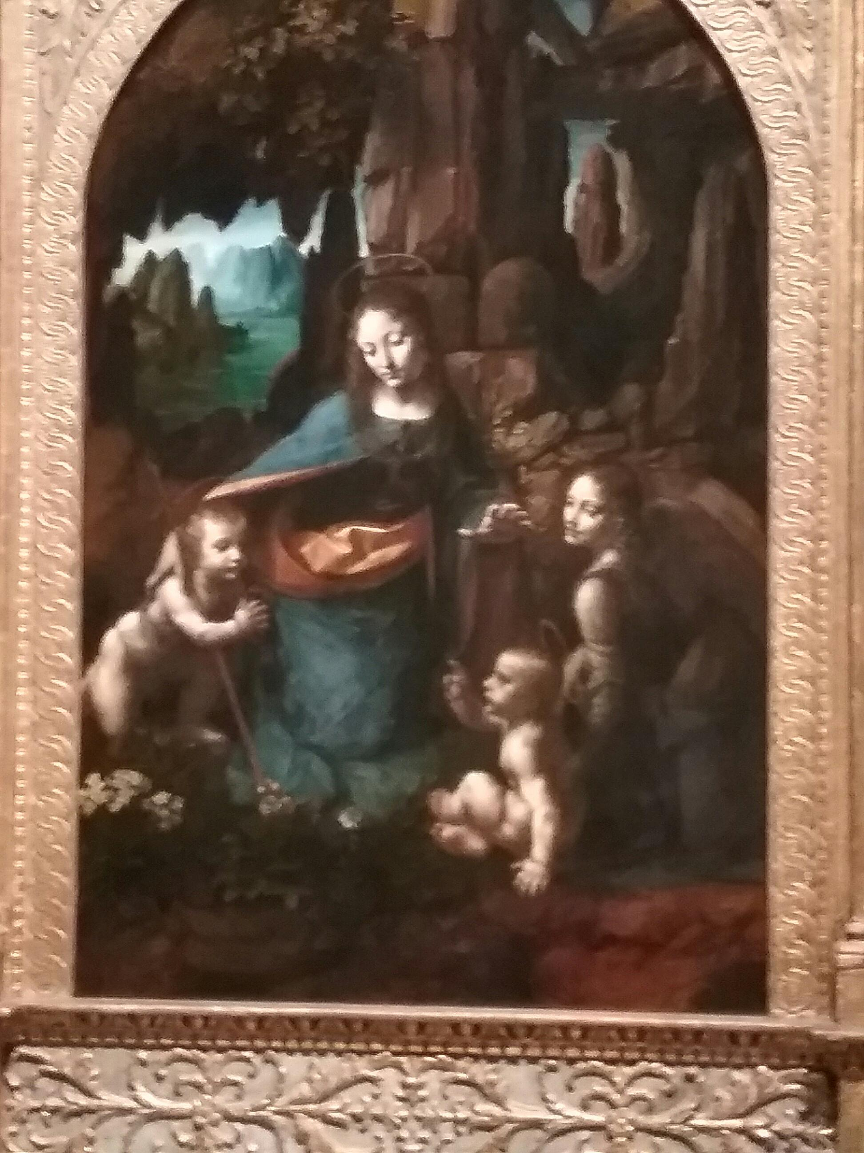
Leonardo da Vinci. The Virgin of the Rocks

Slide 14
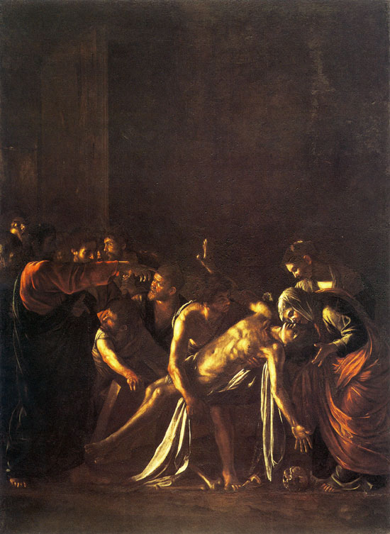
Michelangelo Merisi da Caravaggio. The Raising of Lazarus

Slide 15
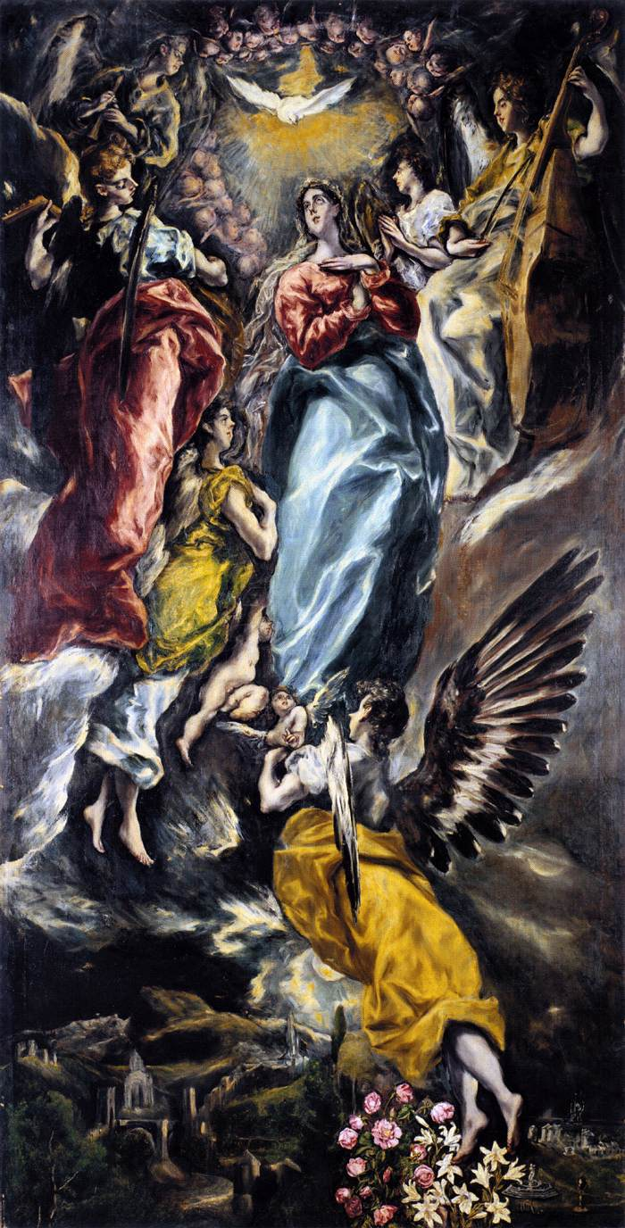
El Greco. The immaculate conception

Slide 16
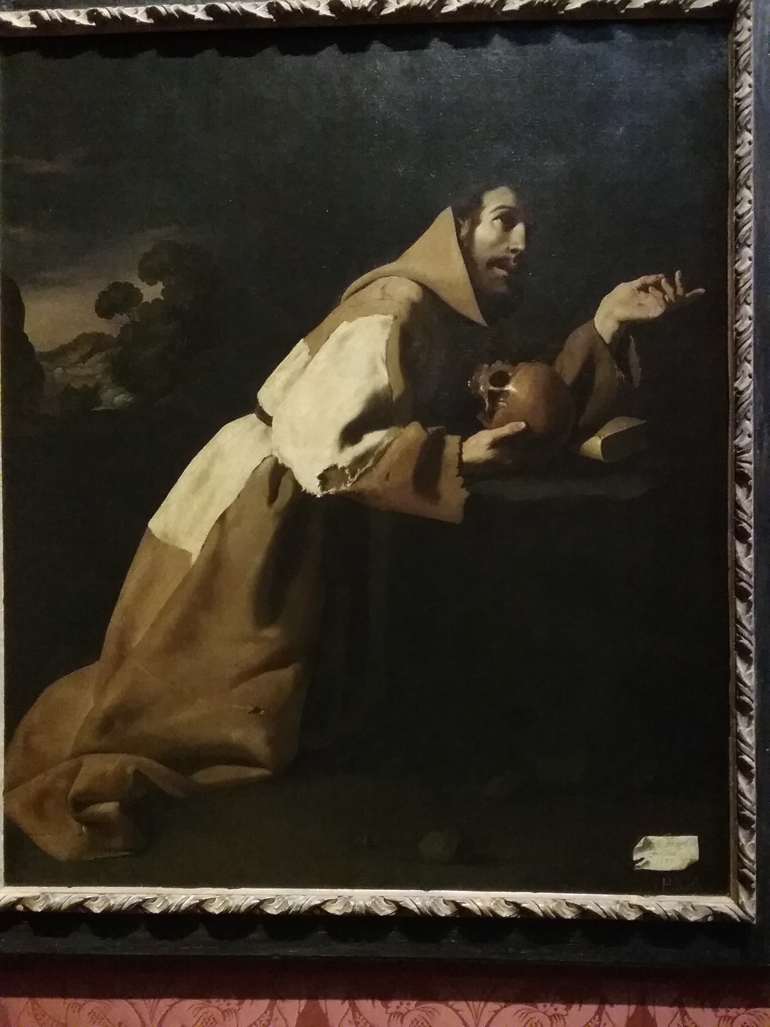
Zurburan. St. Francis in Meditation

Slide 17
3.The light of experience. Illuminatory light. Vermeer de Hoogh, Rembrandt
The relationship between light as mystical drama or ‘revelatory light’ starts to become understood more in terms of an experiential light, especially in the early Dutch republic. Discoveries in optics (COMPLETE EXAMPLE) can be seen to be translated in practical visual terms in the works of artists like Vermeer and de Hoogh. A more humanist based context for the representation of light- both the human experience of the phenomenon of light and of human experience itself become readily apparnt in the work of Rembrandt. Gradually a de-sacralisation of light occurs in painting. This is replaced by repreentations of light which privilege human sense perception and an acknowledgement of an individualised human experience of light as something that plays to individual sense perception

Slide 18
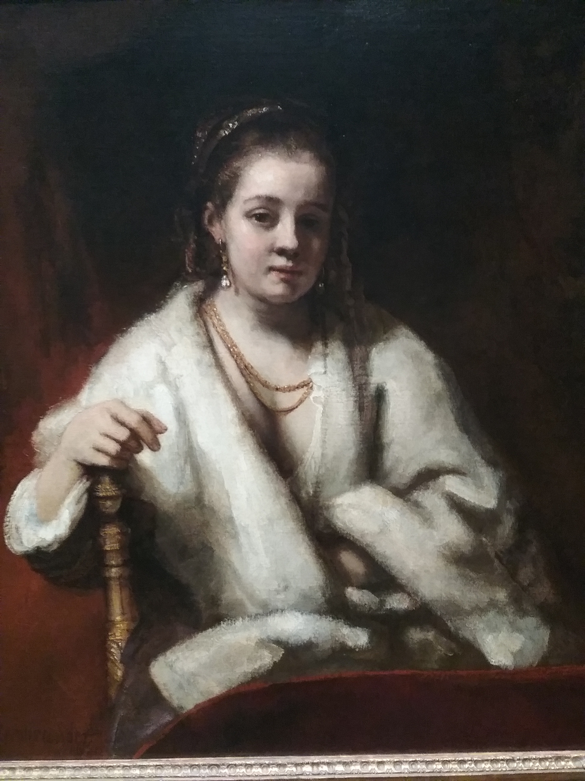
Rembrandt. Portrait of Hendrijke Stoffels

Slide 19
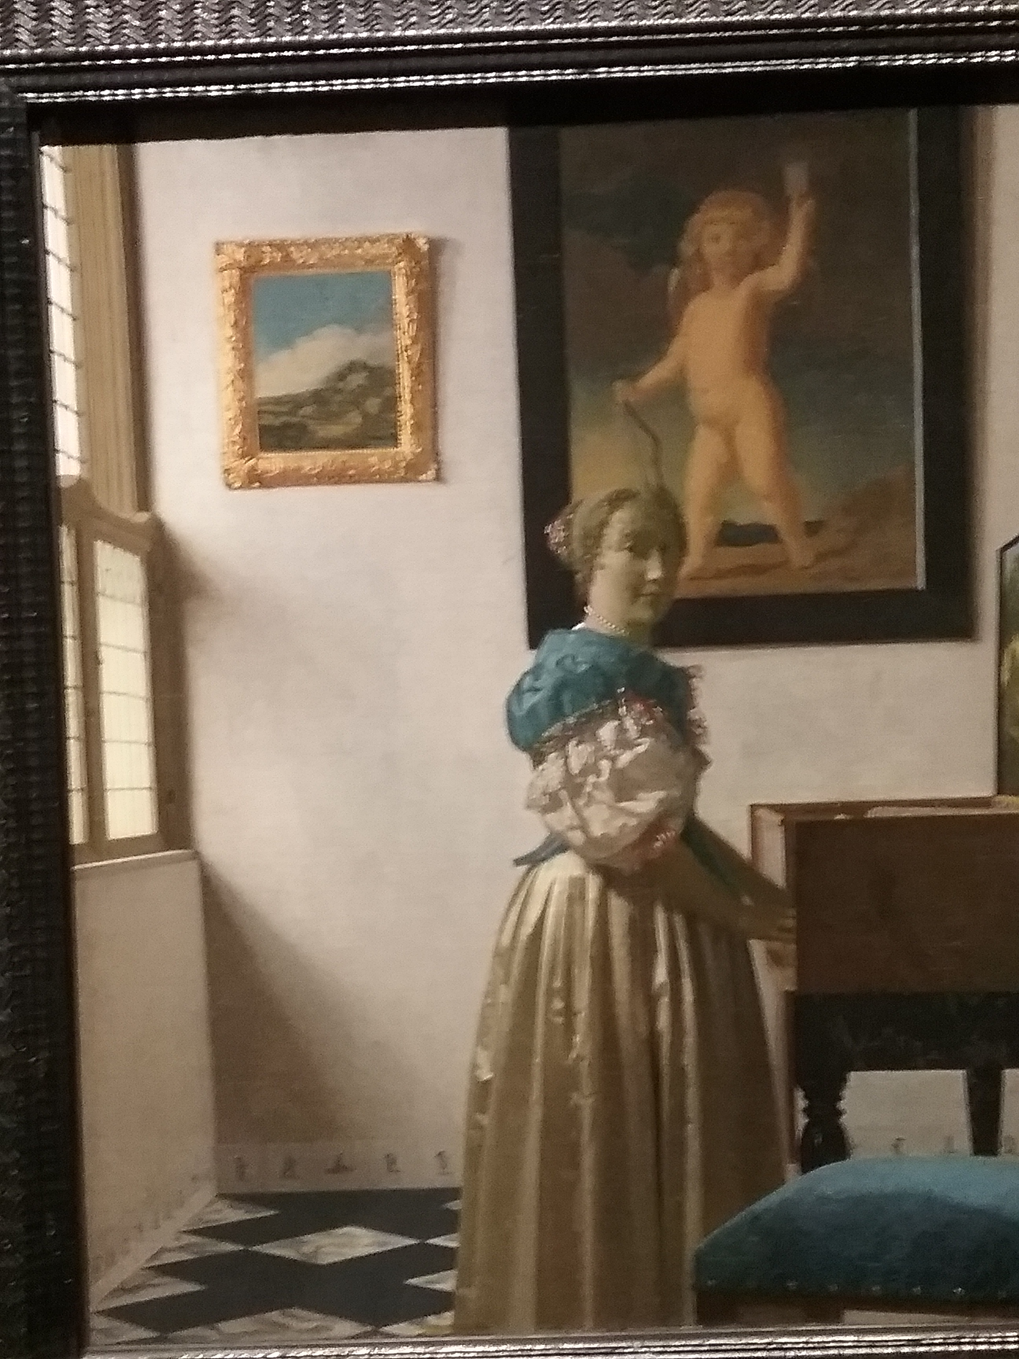
Johannes Vermeer. Girl at a Virginal

Slide 20
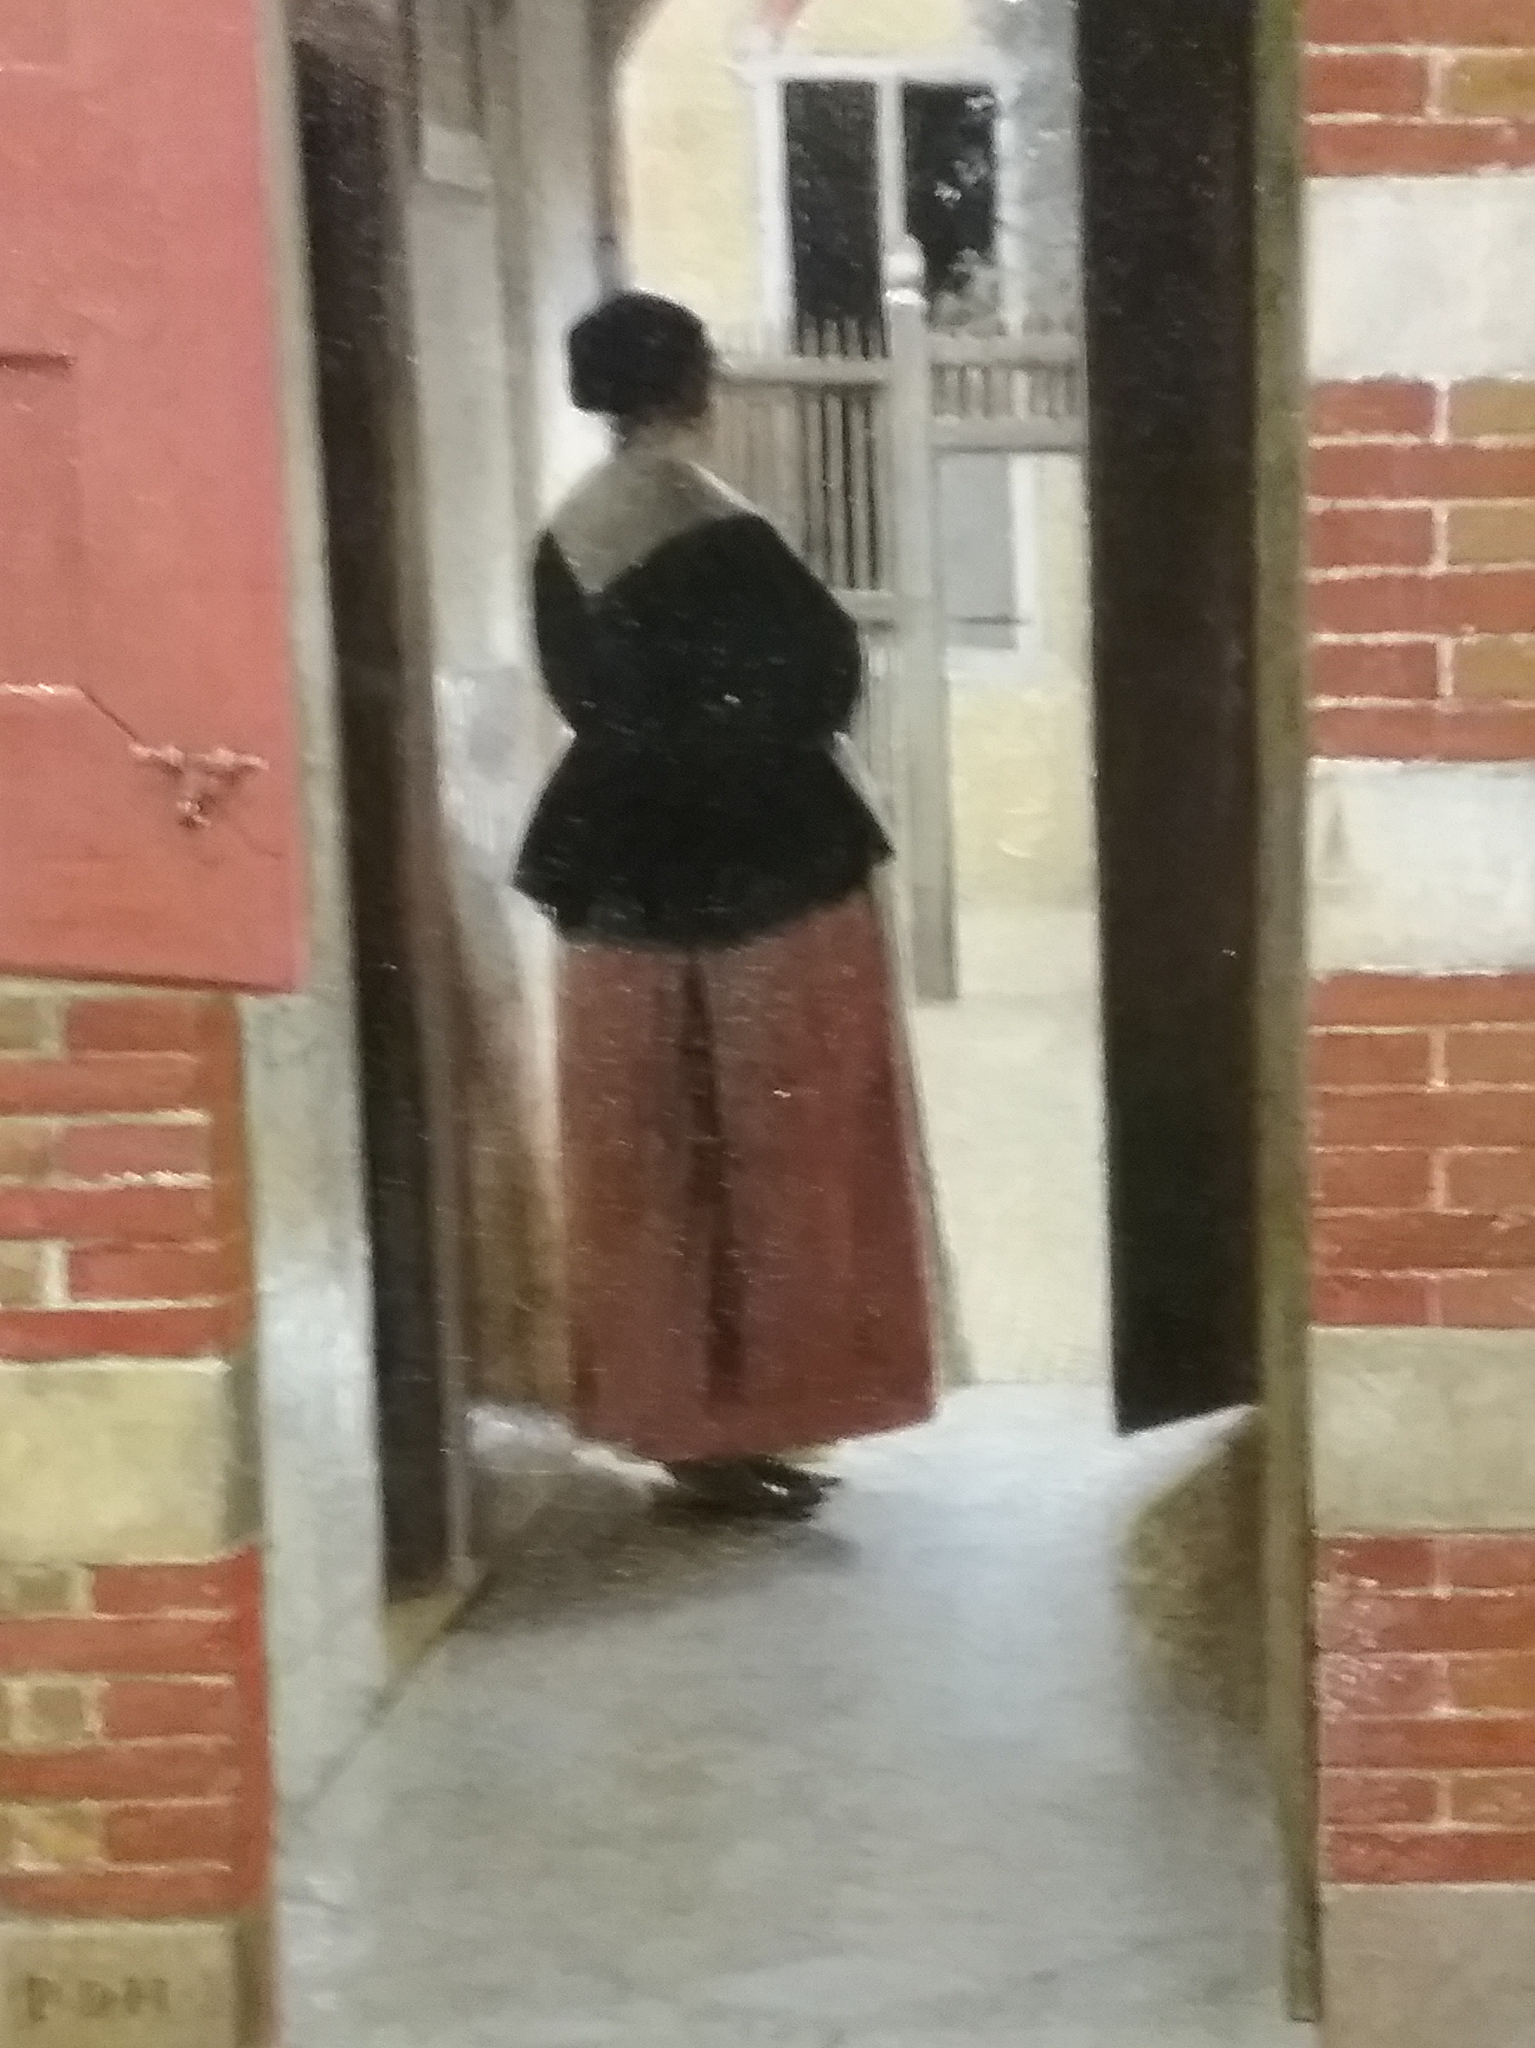
Pieter de Hoogh. A Dutch Courtyard(detail)

Slide 21
4. Light as Aesthetic Experience. (Naturalism, Romanticism and Impressionism)
The primacy of individual perception of empirical evidence of the world features highly in Painting of the Enlightenment and the Age of Reason. The evidence of the senses is a feature of the paintings of Constable, Chardin, which are informed by a respect for natural appearances.
Individual sensibility is a characteristic feature of Romanticism and artists respond to the depiction of light in a way that is transmitted and transmuted according to the personal temperament of the artist. So Turner, for example, for whom the sun was God adopts a pantheistic and immersive approach to the depiction of light that reveals a particul;ar artistic personality. Whereas Caspar David Friedrich displaces the former religious depiction of light onto landscape and thus his painting of light is imbued with a sense of religiosity. Thids also applies to the works of The Pre-Raphaelites in Britain, notably Holman Hunt’s The Light of the World.’ Impressionism (Monet, Renoir, Seurat) apply Chevreul’s scientific theory of complimentary colour to overlay their personal sense perceptions with a scientific basis in colour theory to create paintings of spectacular luminosity

Slide 22
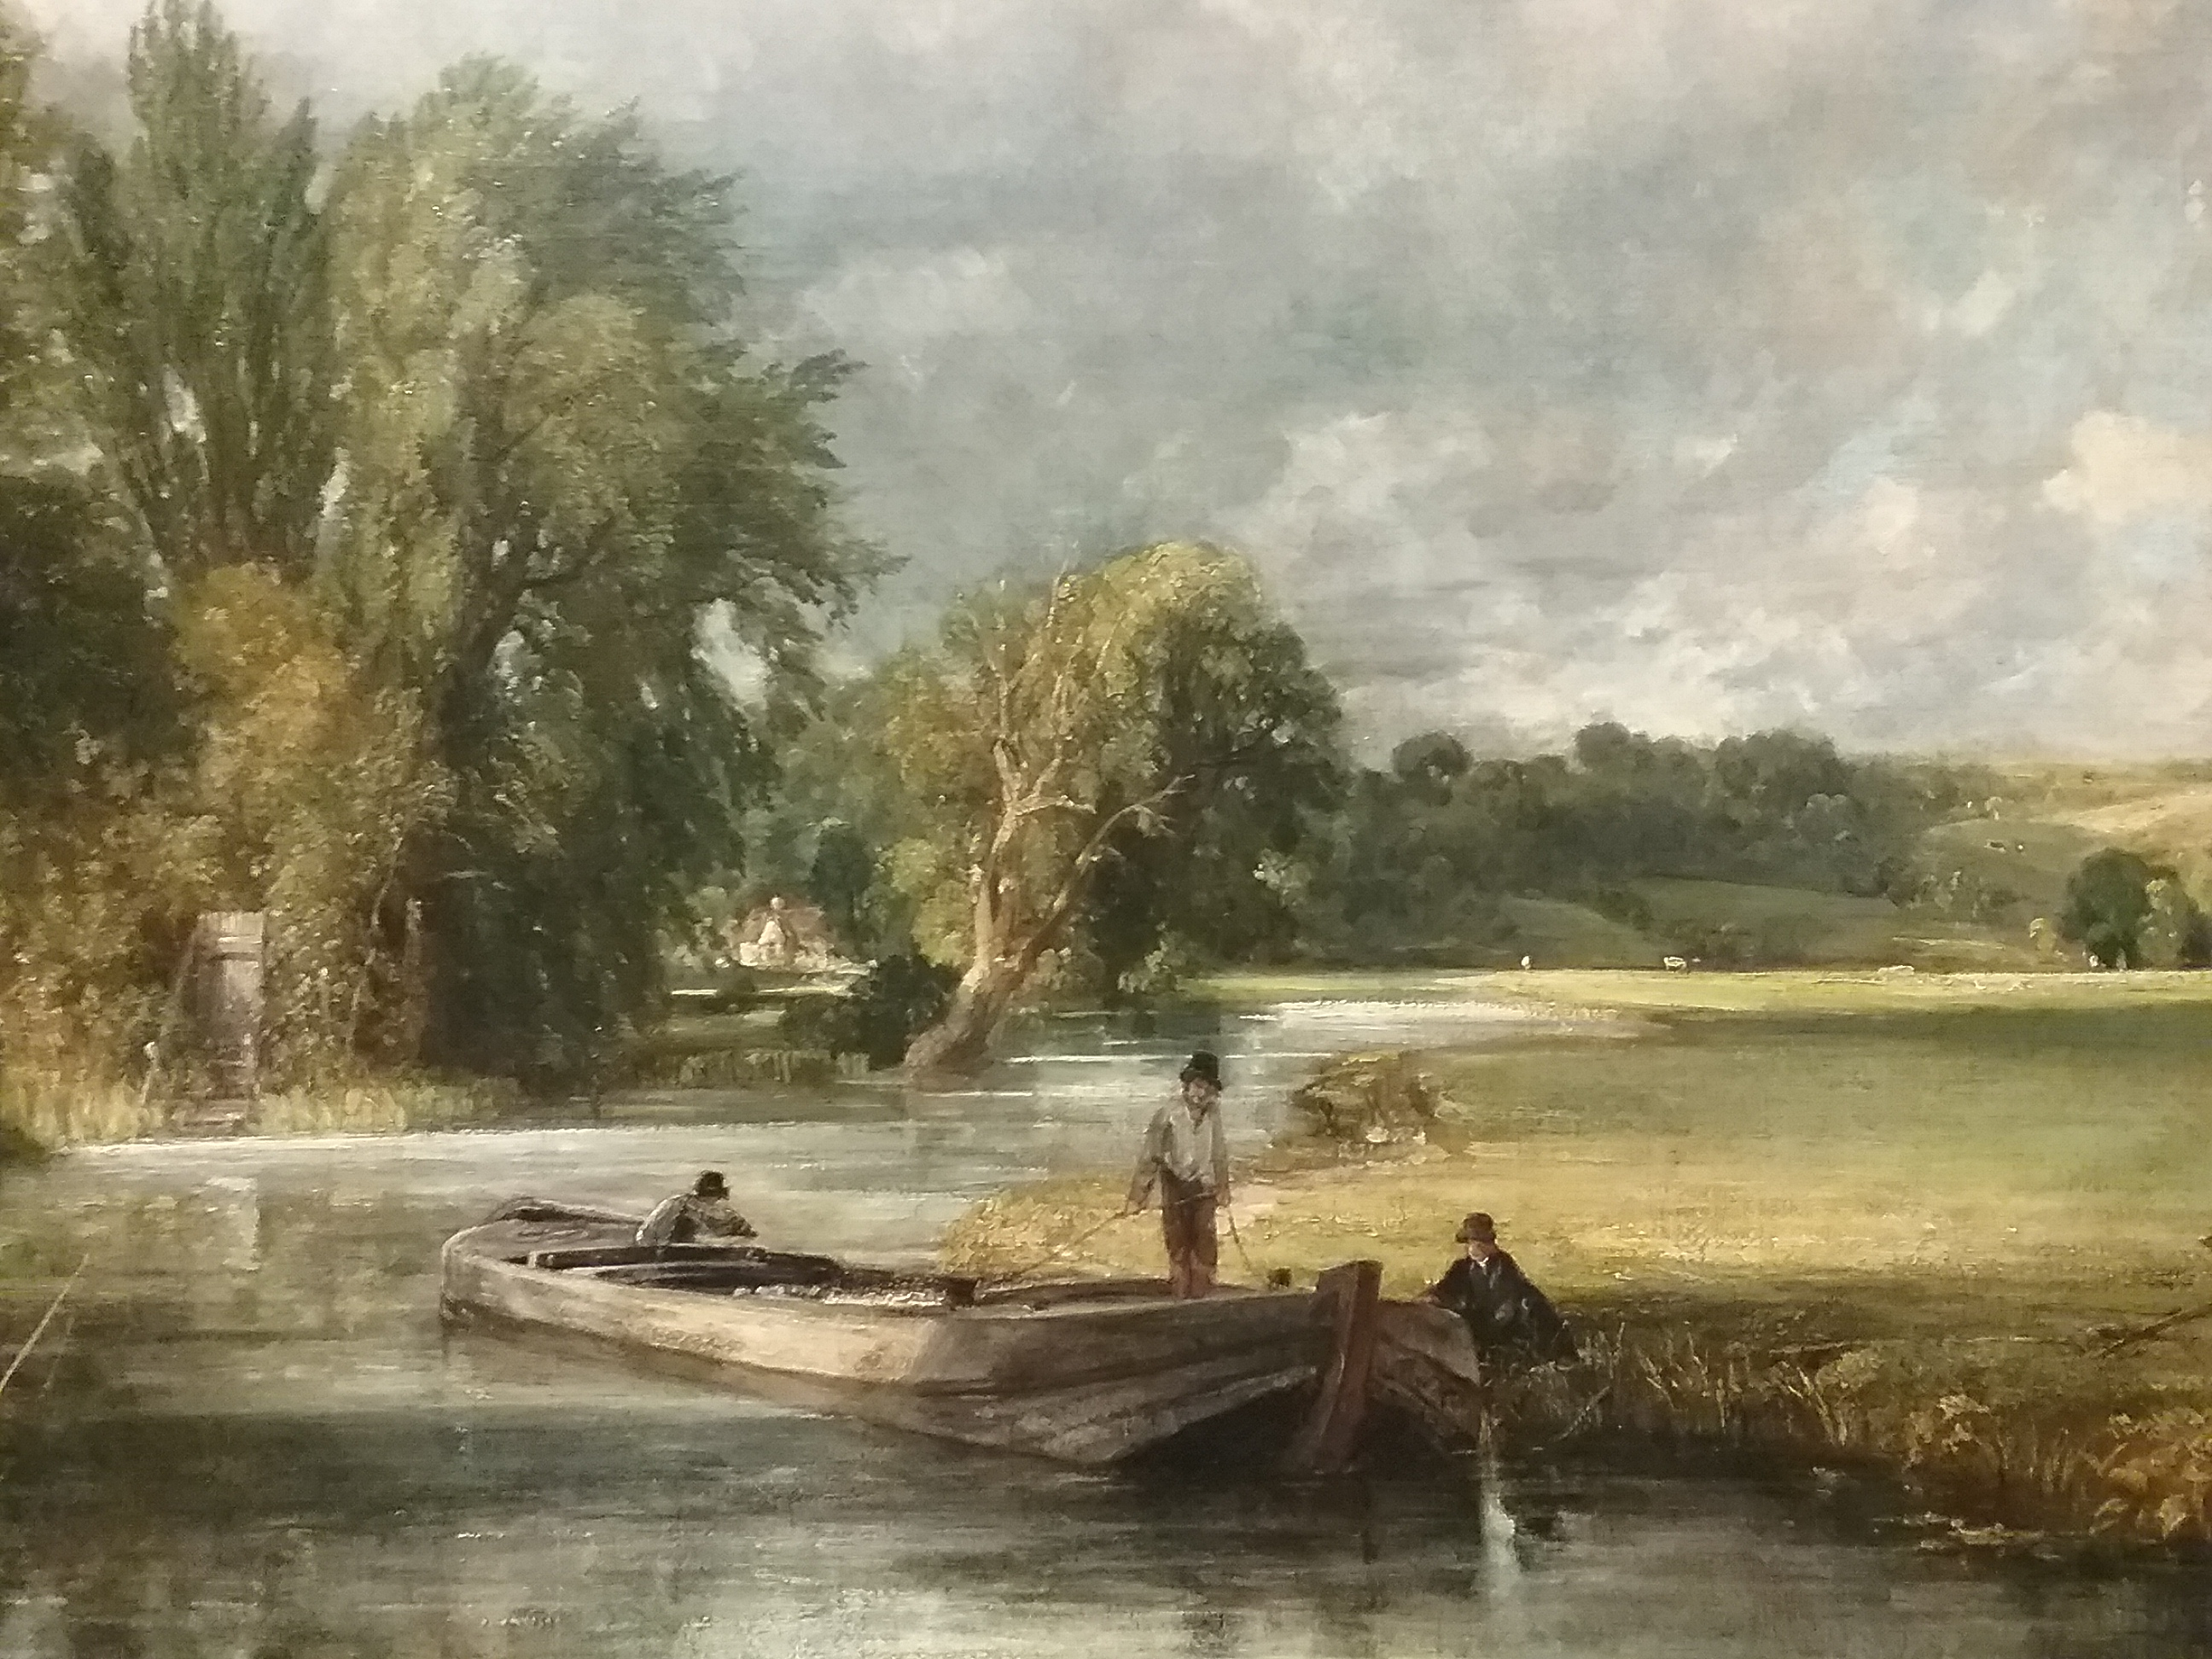
John Constable. Stratford Mill

Slide 23
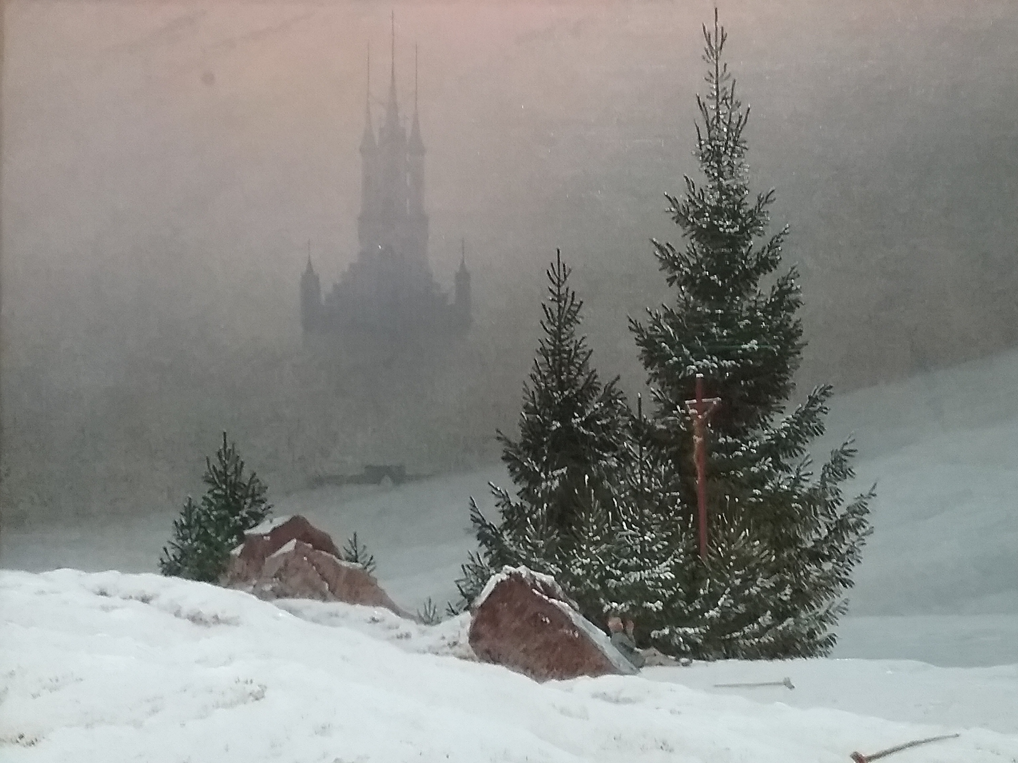
Caspar David Friedrich. Winter Landscape

Slide 24
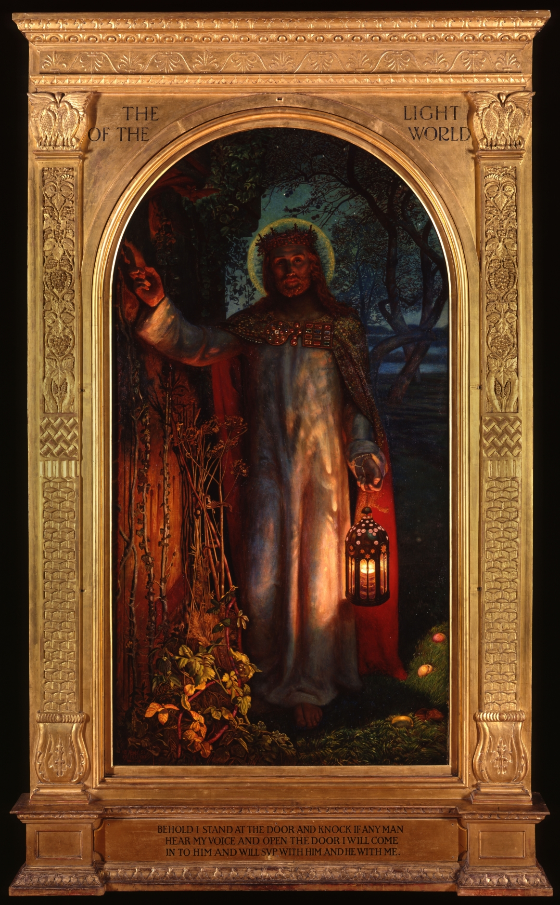
William Holman Hunt. The Light of the World

Slide 25
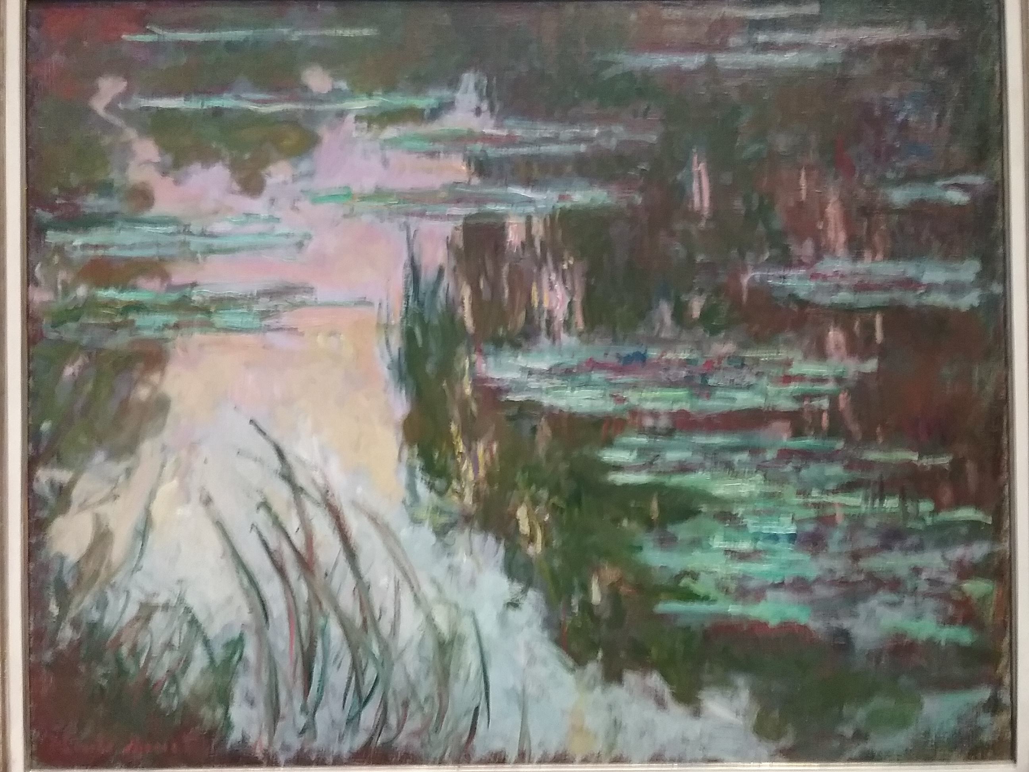
Claude Monet. Waterlillies

Slide 26
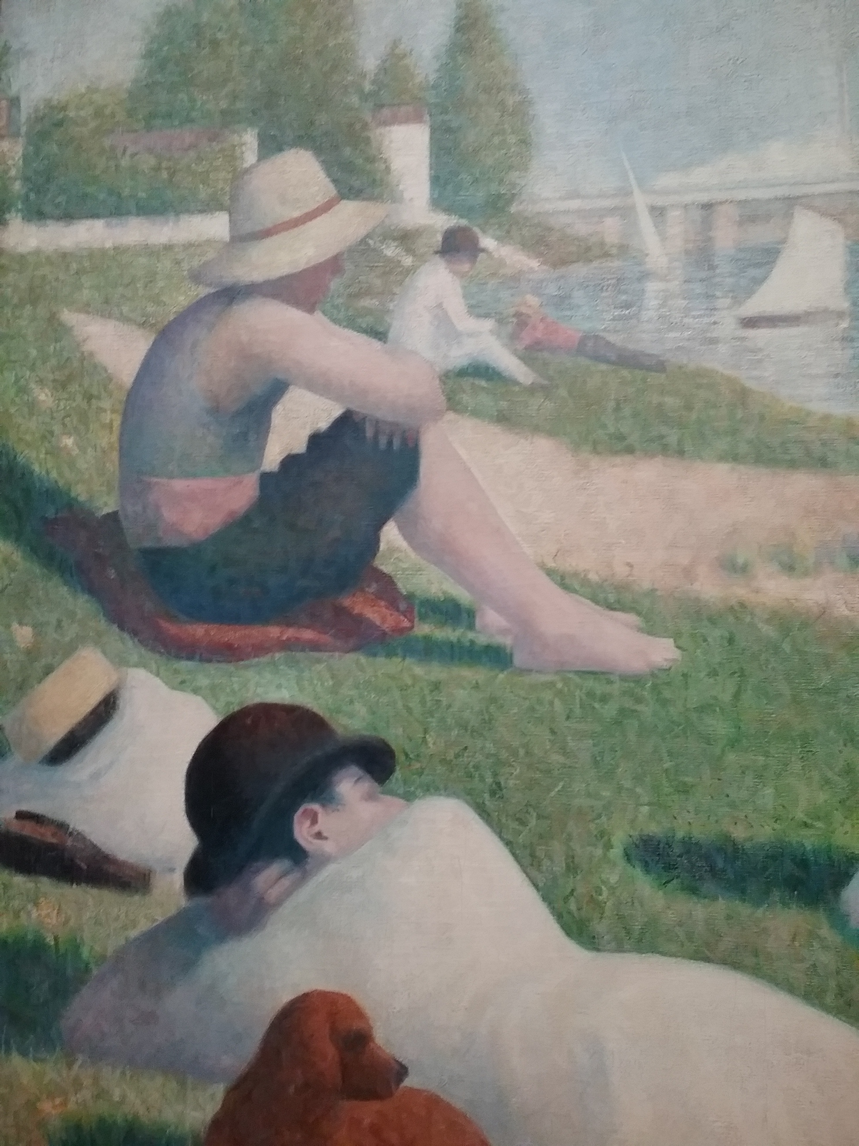
George Seurat. Bathers at Asnieres

Slide 27
5. The Representation of Light in the Technological and Digital Age.
The use of a new technological medium in the aerly 19c- photography - to create images based on chemical reaction to light has a profound and far-reaching impact on traditional painting. Appearances of light can now be recorded and reproduced on a mass scale and its evolution into the moving photographic image (cinema) toward the end of 19c means that the representation of light in painting either ceases to be about the mimetic copying of natural appearances but painting itself – the surface of painting- starts to become the generator of light, as for example can be seen in the work of Matisse (The red Studio) and later Abstract Expressionist work (Rothko, Still, Nerwman) or Painting mimics the photographic surface (Richter- I make photographs using paint) and Warhol’s painted silkscreens of photographs from mass culture. The possibilities which digital technologies have afforded the representation of ligjht in paintimng are exemplified in the work of Jeff Koons’ hyper-real, hyperluminous pop from mass consumer culture

Slide 28
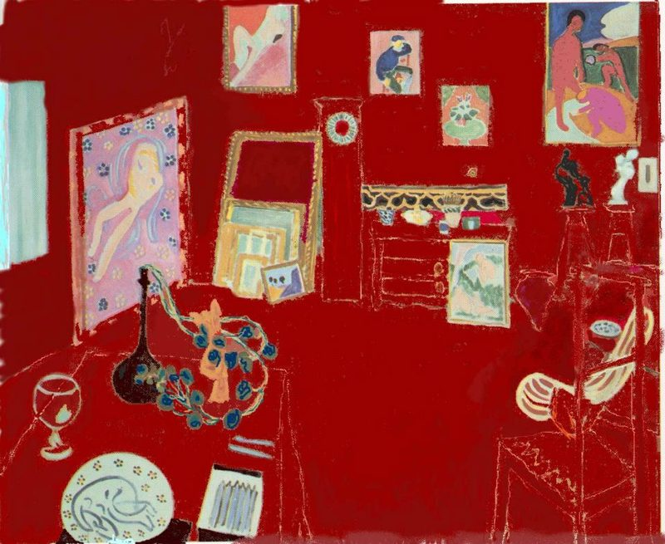
Henri Matisse. The Red Studio

Slide 29
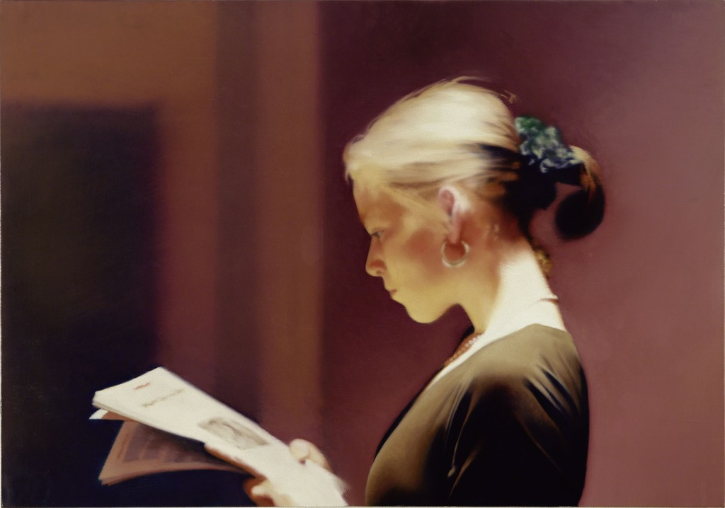
Gerhard Richter. Girl Reading

Slide 30
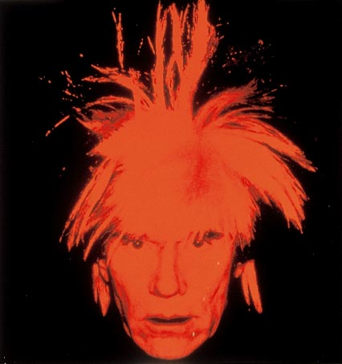
Andy Warhol. Self portrait

Slide 31
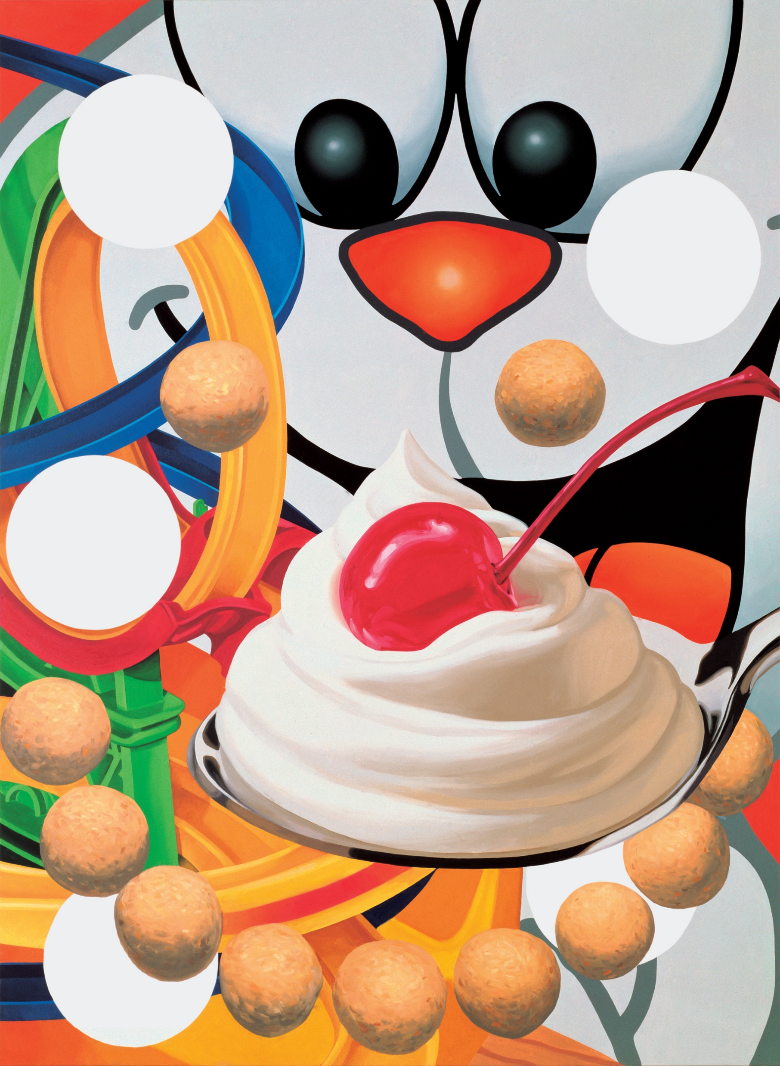
Jeff Koons. Easyfun series

Slide 32
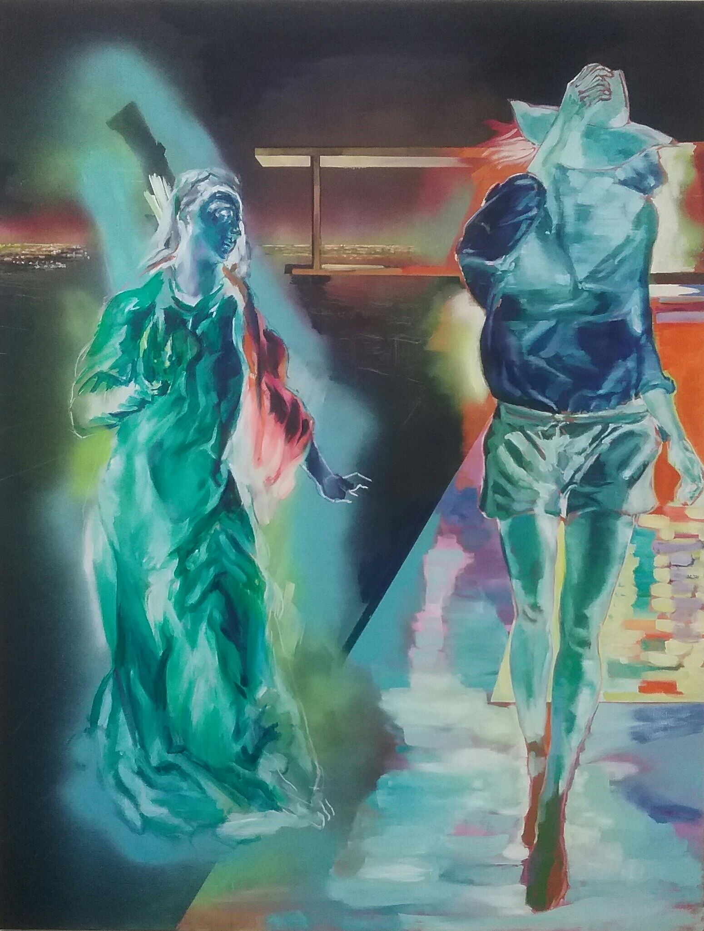
Nicholas Wyatt. Ecce Ancilla Domini. 2017

